Slide 1

Azure Service Fabric for Developers

Slide 2
Microservices vs. Monoliths

Slide 3

Monolithic application approach
Microservices application approach
A monolithic application has most of its functionality within a few processes that are componentized with libraries.
Scales by cloning the app on multiple servers/VMs/Containers
App 1
App 1
App 2
A microservice application separates functionality into separate smaller services.
Scales out by deploying each service independently creating instances of these services across servers/VMs/containers

Slide 4
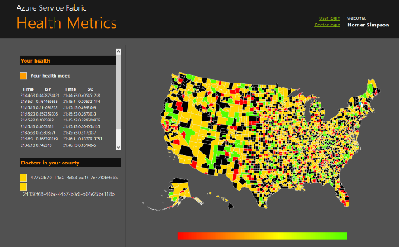

State in Monolithic approach
State in Microservices approach
Single monolithic database
Tiers of specific technologies
Graph of interconnected microservices
State typically scoped to the microservice
Variety of technologies used
Remote Storage for cold data
stateless presentation services
stateless services
stateful services
stateless services with
separate stores

Slide 5
Microsoft Azure Service Fabric A platform for reliable, hyperscale, microservice-based applications
Microservices
High Availability
Data Partitioning
Service Fabric
Health Monitoring
Code Orchestration & Lifecycle Management
Hybrid Operations
Self-healing
Simple programming models
High Density
Rolling Upgrades
Low Latency
Placement Constraints
Replication & Failover
Stateful Services
Fast Startup & Shutdown
Resource Management
Hyper-Scale
Automated Rollback
Azure
Private cloud
Other clouds

Slide 6
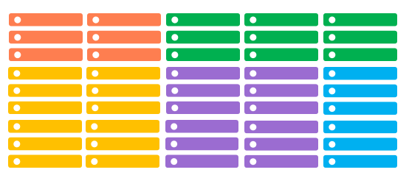
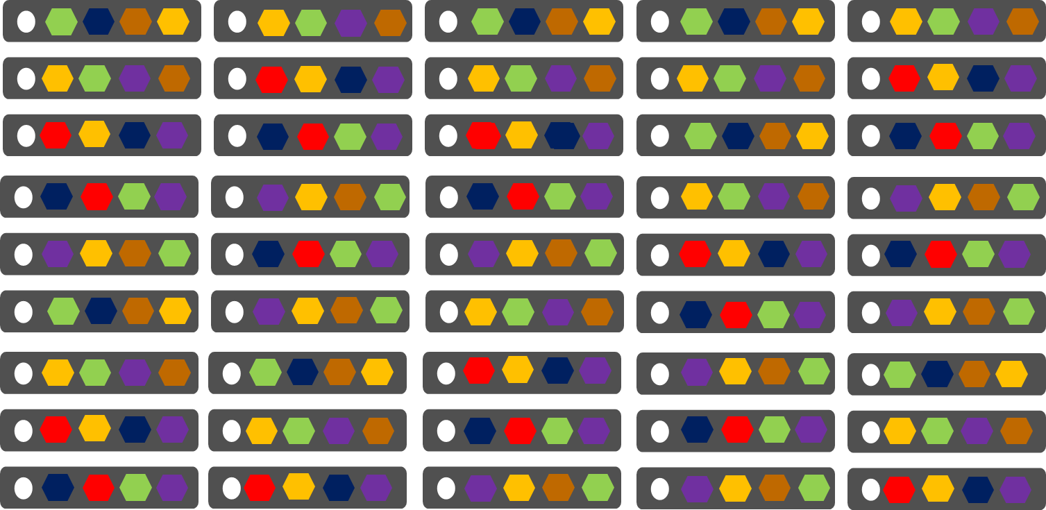
Comparing Azure Cloud Services vs. Azure Service Fabric
Azure Cloud Services
(Web and Worker Roles)
Azure Service Fabric
(Stateless, Stateful or Actor services)
1 role instance per VM
Uneven utilization
Low density
Slow deployment & upgrade (bound to VM)
Slow scaling and failure recovery
Limited fault tolerance
Many microservices per VM
Even Utilization (by default, customizable)
High density (customizable)
Fast deployment & upgrade
Fast scaling of independent microservices
Tunable fast fault tolerance

Slide 7
Cluster
Set of OS instances (real or virtual) stitched together to form a pool of resources
Cluster can scale to 1000s of machines, is self repairing, and scales-up or down
Acts as environment-independent abstraction layer
Windows OS
Windows OS
Windows OS
Fabric
Node
Fabric
Node
Fabric
Node
Windows OS
Windows OS
Windows OS
Fabric
Node
Fabric
Node
Fabric
Node

Slide 8
Demo
Service Fabric Cluster
Setup Local Cluster
Setup Azure Cluster
Service Fabric Explorer

Slide 9
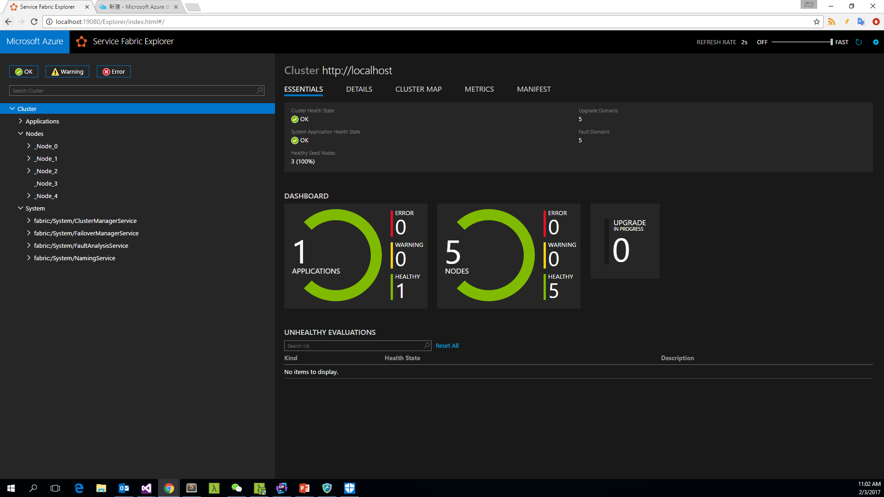

Slide 10
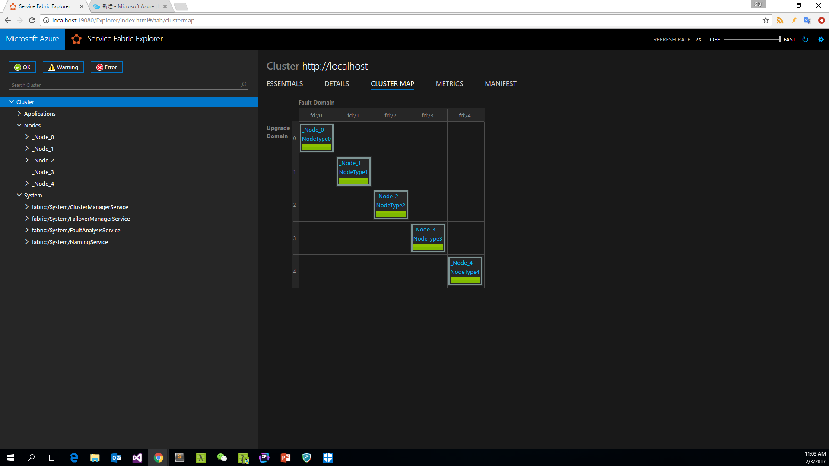

Slide 11
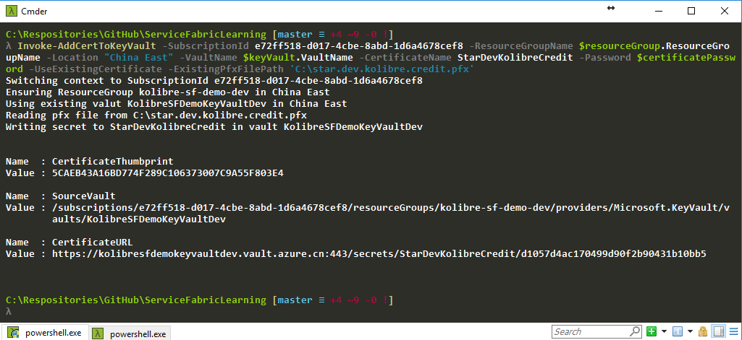
0. 为设置Cluster 安全项创建KeyVault
Notes:
New-AzureRmResourceGroup -Name 'kolibre-sf-demo-dev' -Location 'China East'
$resourceGroup = Get-AzureRmResourceGroup -Name 'kolibre-sf-demo-dev'
$keyVault = New-AzureRmKeyVault -VaultName 'KolibreSFDemoKeyVaultDev' -ResourceGroupName $resourceGroup.ResourceGroupName - Location 'China East' -EnabledForDeployment
$certificatePassword = ‘************'
Invoke-AddCertToKeyVault -SubscriptionId e72ff518-d017-4cbe-8abd-1d6a4678cef8 -ResourceGroupName $resourceGroup.ResourceGroupName -Location "China East" -VaultName $keyVault.VaultName -CertificateName StarDevKolibreCredit -Password $certificatePassword -UseExistingCertificate -ExistingPfxFilePath 'C:\star.dev.kolibre.credit.pfx'

Slide 12
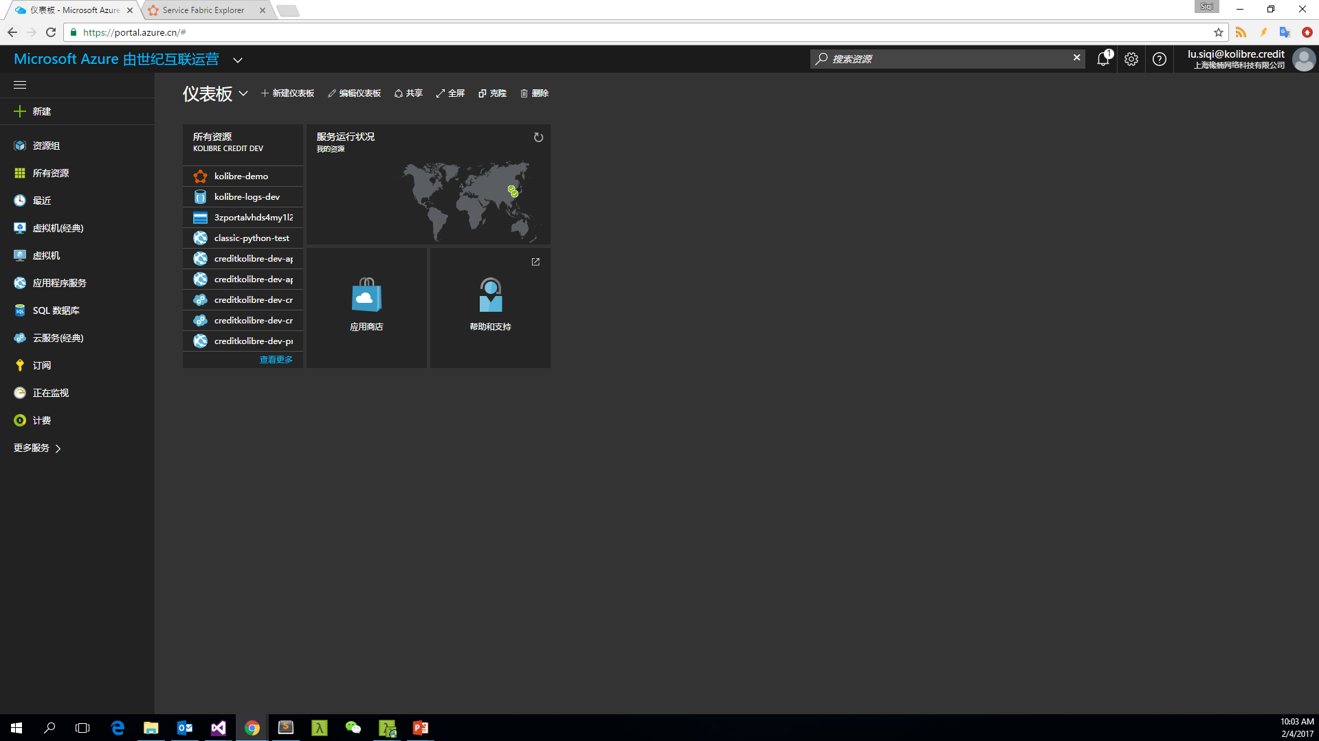
1. 通过 Portal 设置 Azure Cluster

Slide 13
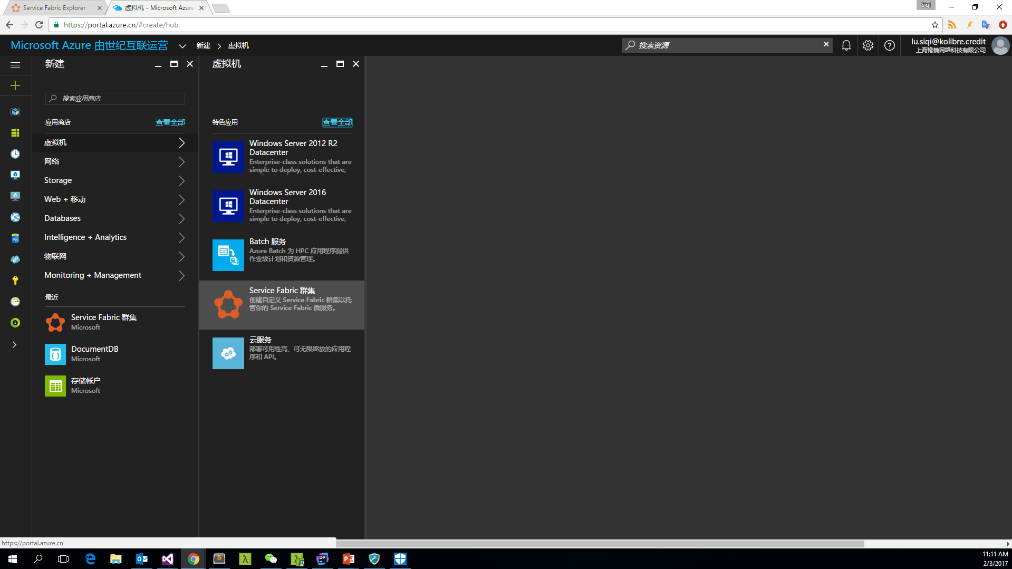
2. 选择创建 Service Fabric 集群

Slide 14
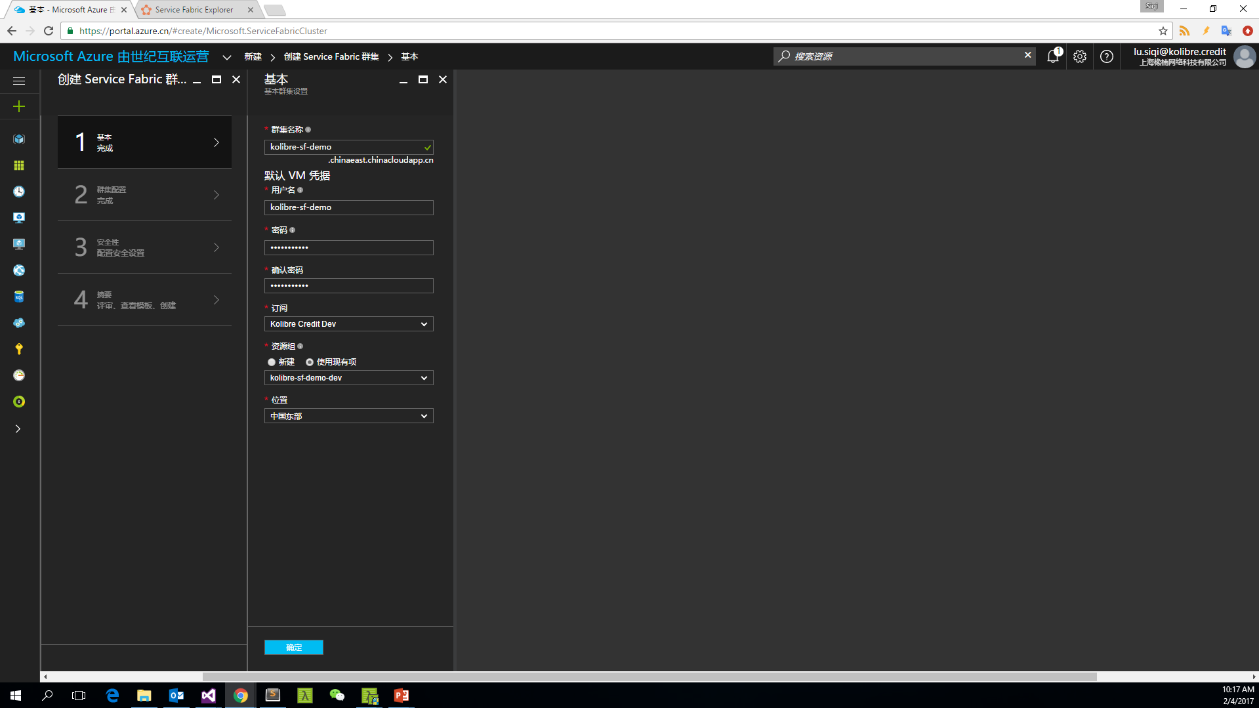
3. 基本
Notes:
集群名称只能小写。命名示例：kolibre-sf-demo-dev
Demo集群的账号和密码为：Kolibre **********
命名规则：-, Pascal, lowercase; 环境值作为后缀
需要提前创建资源组，为了能够同时在改资源组中创建其它资源

Slide 15
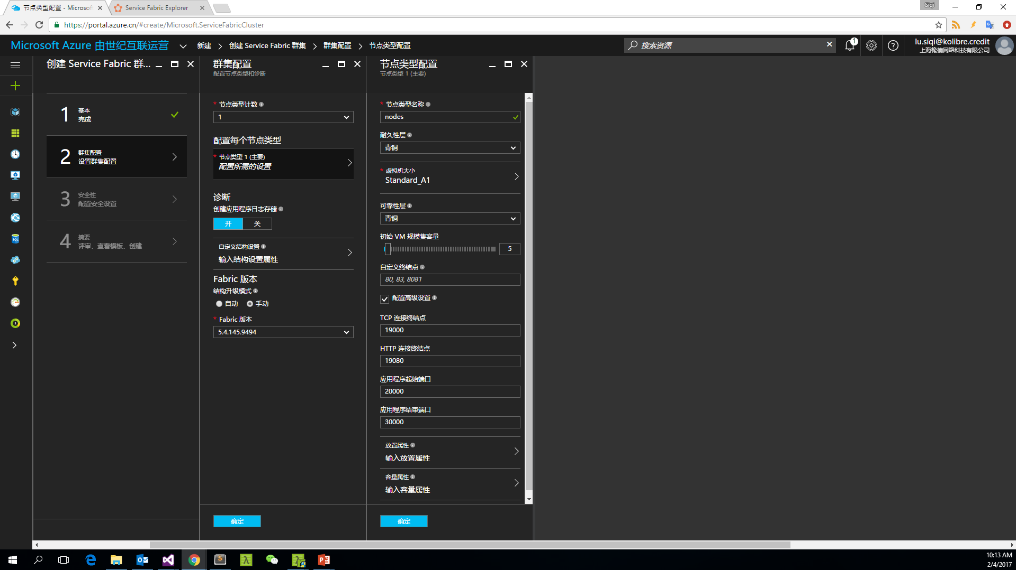
4. 集群配置
Notes:
节点类型计数：设置为 1
开发设置为5节点，生产也设置为5节点

Slide 16
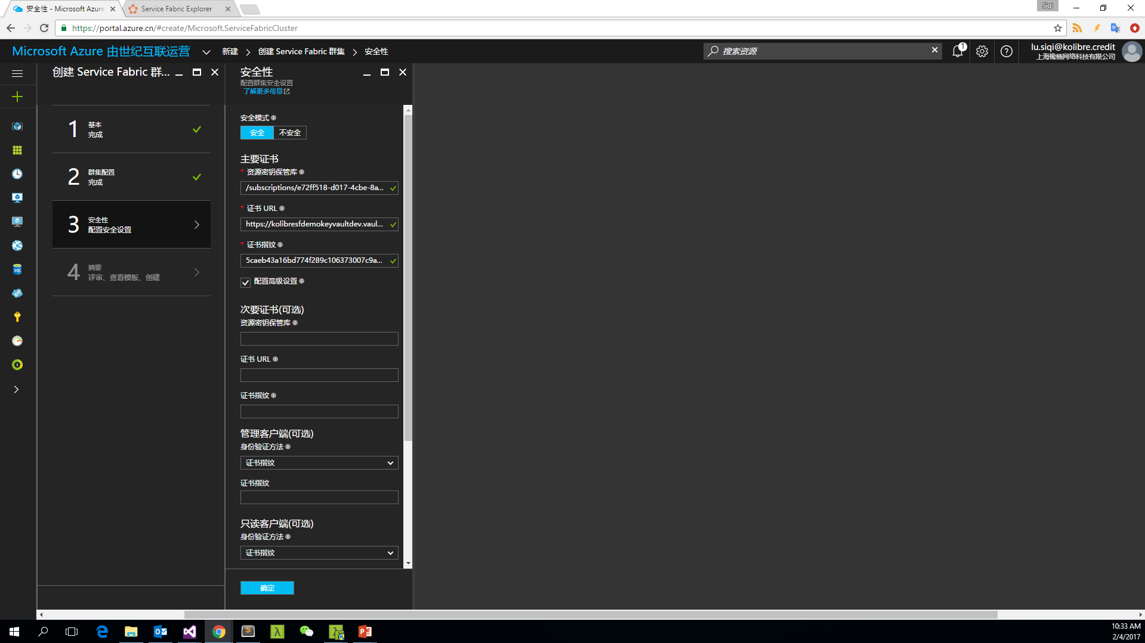
5. 安全性
Notes:
需要准备证书和 AzureKeyVault
资源密钥保管库：/subscriptions/e72ff518-d017-4cbe-8abd-1d6a4678cef8/resourceGroups/kolibre-sf-demo-dev/providers/Microsoft.KeyVault/vaults/KolibreSFDemoKeyVaultDev
证书URL：https://kolibresfdemokeyvaultdev.vault.azure.cn:443/secrets/StarDevKolibreCredit/d1057d4ac170499d90f2b90431b10bb5
证书指纹：5caeb43a16bd774f289c106373007c9a55f803e4
只需要设置服务端证书
安全模型主要依靠网络隔离和人员管理

Slide 17
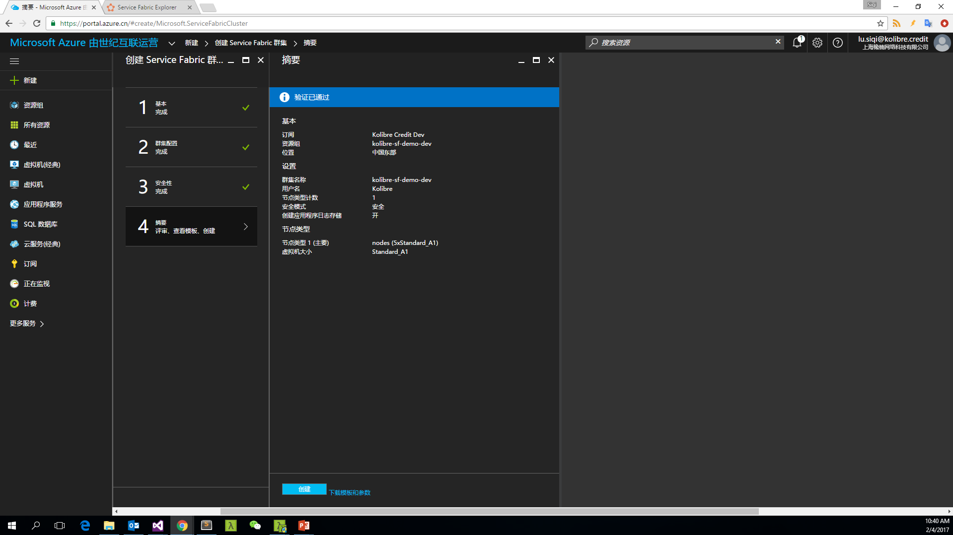
6. 摘要

Slide 18
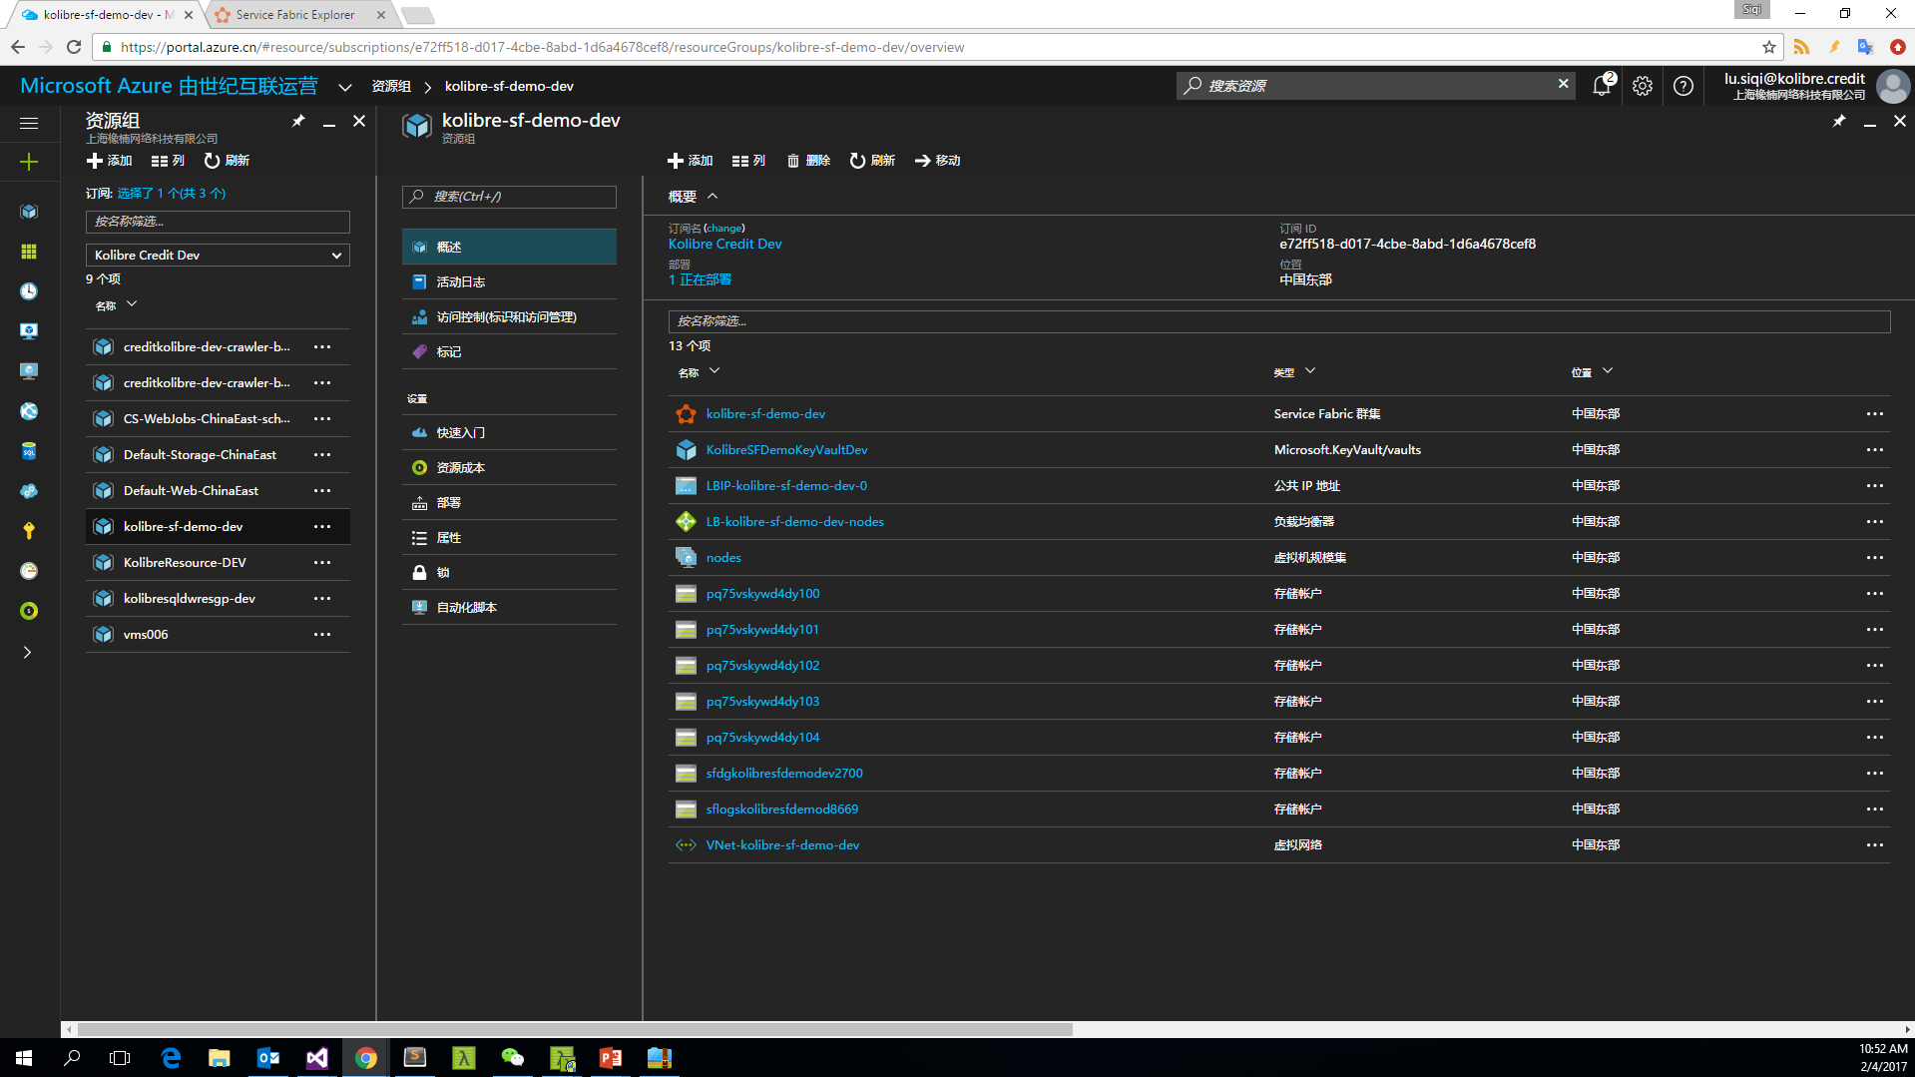
Notes:
{
"$schema": "https://schema.management.azure.com/schemas/2015-01-01/deploymentTemplate.json#",
"contentVersion": "1.0.0.0",
"parameters": {
"virtualMachineScaleSets_nodes_adminPassword": {
"defaultValue": null,
"type": "SecureString"
},
"virtualMachineScaleSets_nodes_name": {
"defaultValue": "nodes",
"type": "String"
},
"vaults_KolibreSFDemoKeyVaultDev_name": {
"defaultValue": "KolibreSFDemoKeyVaultDev",
"type": "String"
},
"loadBalancers_LB_kolibre_sf_demo_dev_nodes_name": {
"defaultValue": "LB-kolibre-sf-demo-dev-nodes",
"type": "String"
},
"publicIPAddresses_LBIP_kolibre_sf_demo_dev_0_name": {
"defaultValue": "LBIP-kolibre-sf-demo-dev-0",
"type": "String"
},
"virtualNetworks_VNet_kolibre_sf_demo_dev_name": {
"defaultValue": "VNet-kolibre-sf-demo-dev",
"type": "String"
},
"clusters_kolibre_sf_demo_dev_name": {
"defaultValue": "kolibre-sf-demo-dev",
"type": "String"
},
"storageAccounts_pq75vskywd4dy100_name": {
"defaultValue": "pq75vskywd4dy100",
"type": "String"
},
"storageAccounts_pq75vskywd4dy101_name": {
"defaultValue": "pq75vskywd4dy101",
"type": "String"
},
"storageAccounts_pq75vskywd4dy102_name": {
"defaultValue": "pq75vskywd4dy102",
"type": "String"
},
"storageAccounts_pq75vskywd4dy103_name": {
"defaultValue": "pq75vskywd4dy103",
"type": "String"
},
"storageAccounts_pq75vskywd4dy104_name": {
"defaultValue": "pq75vskywd4dy104",
"type": "String"
},
"storageAccounts_sfdgkolibresfdemodev2700_name": {
"defaultValue": "sfdgkolibresfdemodev2700",
"type": "String"
},
"storageAccounts_sflogskolibresfdemod8669_name": {
"defaultValue": "sflogskolibresfdemod8669",
"type": "String"
},
"loadBalancers_LB_kolibre_sf_demo_dev_nodes_id": {
"defaultValue": "/subscriptions/e72ff518-d017-4cbe-8abd-1d6a4678cef8/resourceGroups/kolibre-sf-demo-dev/providers/Microsoft.Network/loadBalancers/LB-kolibre-sf-demo-dev-nodes/frontendIPConfigurations/LoadBalancerIPConfig",
"type": "String"
},
"loadBalancers_LB_kolibre_sf_demo_dev_nodes_id_1": {
"defaultValue": "/subscriptions/e72ff518-d017-4cbe-8abd-1d6a4678cef8/resourceGroups/kolibre-sf-demo-dev/providers/Microsoft.Network/loadBalancers/LB-kolibre-sf-demo-dev-nodes/backendAddressPools/LoadBalancerBEAddressPool",
"type": "String"
},
"loadBalancers_LB_kolibre_sf_demo_dev_nodes_id_2": {
"defaultValue": "/subscriptions/e72ff518-d017-4cbe-8abd-1d6a4678cef8/resourceGroups/kolibre-sf-demo-dev/providers/Microsoft.Network/loadBalancers/LB-kolibre-sf-demo-dev-nodes/probes/FabricGatewayProbe",
"type": "String"
},
"loadBalancers_LB_kolibre_sf_demo_dev_nodes_id_3": {
"defaultValue": "/subscriptions/e72ff518-d017-4cbe-8abd-1d6a4678cef8/resourceGroups/kolibre-sf-demo-dev/providers/Microsoft.Network/loadBalancers/LB-kolibre-sf-demo-dev-nodes/frontendIPConfigurations/LoadBalancerIPConfig",
"type": "String"
},
"loadBalancers_LB_kolibre_sf_demo_dev_nodes_id_4": {
"defaultValue": "/subscriptions/e72ff518-d017-4cbe-8abd-1d6a4678cef8/resourceGroups/kolibre-sf-demo-dev/providers/Microsoft.Network/loadBalancers/LB-kolibre-sf-demo-dev-nodes/backendAddressPools/LoadBalancerBEAddressPool",
"type": "String"
},
"loadBalancers_LB_kolibre_sf_demo_dev_nodes_id_5": {
"defaultValue": "/subscriptions/e72ff518-d017-4cbe-8abd-1d6a4678cef8/resourceGroups/kolibre-sf-demo-dev/providers/Microsoft.Network/loadBalancers/LB-kolibre-sf-demo-dev-nodes/probes/FabricHttpGatewayProbe",
"type": "String"
},
"loadBalancers_LB_kolibre_sf_demo_dev_nodes_id_6": {
"defaultValue": "/subscriptions/e72ff518-d017-4cbe-8abd-1d6a4678cef8/resourceGroups/kolibre-sf-demo-dev/providers/Microsoft.Network/loadBalancers/LB-kolibre-sf-demo-dev-nodes/frontendIPConfigurations/LoadBalancerIPConfig",
"type": "String"
},
"loadBalancers_LB_kolibre_sf_demo_dev_nodes_id_7": {
"defaultValue": "/subscriptions/e72ff518-d017-4cbe-8abd-1d6a4678cef8/resourceGroups/kolibre-sf-demo-dev/providers/Microsoft.Network/loadBalancers/LB-kolibre-sf-demo-dev-nodes/frontendIPConfigurations/LoadBalancerIPConfig",
"type": "String"
},
"loadBalancers_LB_kolibre_sf_demo_dev_nodes_id_8": {
"defaultValue": "/subscriptions/e72ff518-d017-4cbe-8abd-1d6a4678cef8/resourceGroups/kolibre-sf-demo-dev/providers/Microsoft.Network/loadBalancers/LB-kolibre-sf-demo-dev-nodes/frontendIPConfigurations/LoadBalancerIPConfig",
"type": "String"
},
"loadBalancers_LB_kolibre_sf_demo_dev_nodes_id_9": {
"defaultValue": "/subscriptions/e72ff518-d017-4cbe-8abd-1d6a4678cef8/resourceGroups/kolibre-sf-demo-dev/providers/Microsoft.Network/loadBalancers/LB-kolibre-sf-demo-dev-nodes/frontendIPConfigurations/LoadBalancerIPConfig",
"type": "String"
},
"loadBalancers_LB_kolibre_sf_demo_dev_nodes_id_10": {
"defaultValue": "/subscriptions/e72ff518-d017-4cbe-8abd-1d6a4678cef8/resourceGroups/kolibre-sf-demo-dev/providers/Microsoft.Network/loadBalancers/LB-kolibre-sf-demo-dev-nodes/frontendIPConfigurations/LoadBalancerIPConfig",
"type": "String"
},
"loadBalancers_LB_kolibre_sf_demo_dev_nodes_id_11": {
"defaultValue": "/subscriptions/e72ff518-d017-4cbe-8abd-1d6a4678cef8/resourceGroups/kolibre-sf-demo-dev/providers/Microsoft.Network/loadBalancers/LB-kolibre-sf-demo-dev-nodes/frontendIPConfigurations/LoadBalancerIPConfig",
"type": "String"
}
},
"variables": {},
"resources": [
{
"comments": "已从资源实现通用:“/subscriptions/e72ff518-d017-4cbe-8abd-1d6a4678cef8/resourceGroups/kolibre-sf-demo-dev/providers/Microsoft.Compute/virtualMachineScaleSets/nodes”。",
"type": "Microsoft.Compute/virtualMachineScaleSets",
"sku": {
"name": "Standard_A1",
"tier": "Standard",
"capacity": 5
},
"name": "[parameters('virtualMachineScaleSets_nodes_name')]",
"apiVersion": "2015-06-15",
"location": "chinaeast",
"tags": {
"resourceType": "Service Fabric",
"clusterName": "kolibre-sf-demo-dev"
},
"properties": {
"upgradePolicy": {
"mode": "Automatic"
},
"virtualMachineProfile": {
"osProfile": {
"computerNamePrefix": "[parameters('virtualMachineScaleSets_nodes_name')]",
"adminUsername": "Kolibre",
"windowsConfiguration": {
"provisionVMAgent": true,
"enableAutomaticUpdates": true
},
"secrets": [
{
"sourceVault": {
"id": "[resourceId('Microsoft.KeyVault/vaults', parameters('vaults_KolibreSFDemoKeyVaultDev_name'))]"
},
"vaultCertificates": [
{
"certificateUrl": "https://kolibresfdemokeyvaultdev.vault.azure.cn:443/secrets/StarDevKolibreCredit/d1057d4ac170499d90f2b90431b10bb5"
}
]
}
],
"adminPassword": "[parameters('virtualMachineScaleSets_nodes_adminPassword')]"
},
"storageProfile": {
"osDisk": {
"vhdContainers": [
"https://pq75vskywd4dy100.blob.core.chinacloudapi.cn/vhds",
"https://pq75vskywd4dy101.blob.core.chinacloudapi.cn/vhds",
"https://pq75vskywd4dy102.blob.core.chinacloudapi.cn/vhds",
"https://pq75vskywd4dy103.blob.core.chinacloudapi.cn/vhds",
"https://pq75vskywd4dy104.blob.core.chinacloudapi.cn/vhds"
],
"name": "vmssosdisk",
"createOption": "FromImage",
"caching": "ReadOnly"
},
"imageReference": {
"publisher": "MicrosoftWindowsServer",
"offer": "WindowsServer",
"sku": "2012-R2-Datacenter",
"version": "latest"
}
},
"networkProfile": {
"networkInterfaceConfigurations": [
{
"name": "NIC-kolibre-sf-demo-dev-0",
"properties": {
"primary": true,
"ipConfigurations": [
{
"name": "NIC-kolibre-sf-demo-dev-0",
"properties": {
"subnet": {
"id": "[concat(resourceId('Microsoft.Network/virtualNetworks', parameters('virtualNetworks_VNet_kolibre_sf_demo_dev_name')), '/subnets/Subnet-0')]"
},
"loadBalancerBackendAddressPools": [
{
"id": "[concat(resourceId('Microsoft.Network/loadBalancers', parameters('loadBalancers_LB_kolibre_sf_demo_dev_nodes_name')), '/backendAddressPools/LoadBalancerBEAddressPool')]"
}
],
"loadBalancerInboundNatPools": [
{
"id": "[concat(resourceId('Microsoft.Network/loadBalancers', parameters('loadBalancers_LB_kolibre_sf_demo_dev_nodes_name')), '/inboundNatPools/LoadBalancerBEAddressNatPool')]"
}
]
}
}
]
}
}
]
},
"extensionProfile": {
"extensions": [
{
"properties": {
"publisher": "Microsoft.Azure.ServiceFabric",
"type": "ServiceFabricNode",
"typeHandlerVersion": "1.0",
"autoUpgradeMinorVersion": false,
"settings": {
"clusterEndpoint": "https://chinaeast.servicefabric.chinacloudapi.cn/runtime/clusters/5cf49a0c-da24-45c3-bcca-167977639788",
"nodeTypeRef": "[parameters('virtualMachineScaleSets_nodes_name')]",
"dataPath": "D:\\\\SvcFab",
"durabilityLevel": "Bronze",
"certificate": {
"thumbprint": "5caeb43a16bd774f289c106373007c9a55f803e4",
"x509StoreName": "My"
}
}
},
"name": "[concat(parameters('virtualMachineScaleSets_nodes_name'),'_ServiceFabricNode')]"
},
{
"properties": {
"publisher": "Microsoft.Azure.Diagnostics",
"type": "IaaSDiagnostics",
"typeHandlerVersion": "1.5",
"autoUpgradeMinorVersion": true,
"settings": {
"WadCfg": {
"DiagnosticMonitorConfiguration": {
"overallQuotaInMB": "50000",
"EtwProviders": {
"EtwEventSourceProviderConfiguration": [
{
"provider": "Microsoft-ServiceFabric-Actors",
"scheduledTransferKeywordFilter": "1",
"scheduledTransferPeriod": "PT5M",
"DefaultEvents": {
"eventDestination": "ServiceFabricReliableActorEventTable"
}
},
{
"provider": "Microsoft-ServiceFabric-Services",
"scheduledTransferPeriod": "PT5M",
"DefaultEvents": {
"eventDestination": "ServiceFabricReliableServiceEventTable"
}
}
],
"EtwManifestProviderConfiguration": [
{
"provider": "cbd93bc2-71e5-4566-b3a7-595d8eeca6e8",
"scheduledTransferLogLevelFilter": "Information",
"scheduledTransferKeywordFilter": "4611686018427387904",
"scheduledTransferPeriod": "PT5M",
"DefaultEvents": {
"eventDestination": "ServiceFabricSystemEventTable"
}
}
]
}
}
},
"StorageAccount": "sfdgkolibresfdemodev2700"
}
},
"name": "VMDiagnosticsVmExt_vmNodeType0Name"
}
]
}
}
},
"resources": [],
"dependsOn": [
"[resourceId('Microsoft.KeyVault/vaults', parameters('vaults_KolibreSFDemoKeyVaultDev_name'))]",
"[resourceId('Microsoft.Network/virtualNetworks', parameters('virtualNetworks_VNet_kolibre_sf_demo_dev_name'))]",
"[resourceId('Microsoft.Network/loadBalancers', parameters('loadBalancers_LB_kolibre_sf_demo_dev_nodes_name'))]"
]
},
{
"comments": "已从资源实现通用:“/subscriptions/e72ff518-d017-4cbe-8abd-1d6a4678cef8/resourceGroups/kolibre-sf-demo-dev/providers/Microsoft.KeyVault/vaults/KolibreSFDemoKeyVaultDev”。",
"type": "Microsoft.KeyVault/vaults",
"name": "[parameters('vaults_KolibreSFDemoKeyVaultDev_name')]",
"apiVersion": "2015-06-01",
"location": "China East",
"tags": {},
"properties": {
"sku": {
"family": "A",
"name": "standard"
},
"tenantId": "242c1649-699b-4c67-a0dd-faa3cbb24dd6",
"accessPolicies": [
{
"tenantId": "242c1649-699b-4c67-a0dd-faa3cbb24dd6",
"objectId": "2bce1e41-6f5f-4254-b315-615c6cf34e77",
"permissions": {
"keys": [
"get",
"create",
"delete",
"list",
"update",
"import",
"backup",
"restore"
],
"secrets": [
"all"
]
}
}
],
"enabledForDeployment": true
},
"resources": [],
"dependsOn": []
},
{
"comments": "已从资源实现通用:“/subscriptions/e72ff518-d017-4cbe-8abd-1d6a4678cef8/resourceGroups/kolibre-sf-demo-dev/providers/Microsoft.Network/loadBalancers/LB-kolibre-sf-demo-dev-nodes”。",
"type": "Microsoft.Network/loadBalancers",
"name": "[parameters('loadBalancers_LB_kolibre_sf_demo_dev_nodes_name')]",
"apiVersion": "2016-03-30",
"location": "chinaeast",
"tags": {
"resourceType": "Service Fabric",
"clusterName": "kolibre-sf-demo-dev"
},
"properties": {
"frontendIPConfigurations": [
{
"name": "LoadBalancerIPConfig",
"properties": {
"privateIPAllocationMethod": "Dynamic",
"publicIPAddress": {
"id": "[resourceId('Microsoft.Network/publicIPAddresses', parameters('publicIPAddresses_LBIP_kolibre_sf_demo_dev_0_name'))]"
}
}
}
],
"backendAddressPools": [
{
"name": "LoadBalancerBEAddressPool"
}
],
"loadBalancingRules": [
{
"name": "LBRule",
"properties": {
"frontendIPConfiguration": {
"id": "[parameters('loadBalancers_LB_kolibre_sf_demo_dev_nodes_id')]"
},
"frontendPort": 19000,
"backendPort": 19000,
"enableFloatingIP": false,
"idleTimeoutInMinutes": 5,
"protocol": "Tcp",
"loadDistribution": "Default",
"backendAddressPool": {
"id": "[parameters('loadBalancers_LB_kolibre_sf_demo_dev_nodes_id_1')]"
},
"probe": {
"id": "[parameters('loadBalancers_LB_kolibre_sf_demo_dev_nodes_id_2')]"
}
}
},
{
"name": "LBHttpRule",
"properties": {
"frontendIPConfiguration": {
"id": "[parameters('loadBalancers_LB_kolibre_sf_demo_dev_nodes_id_3')]"
},
"frontendPort": 19080,
"backendPort": 19080,
"enableFloatingIP": false,
"idleTimeoutInMinutes": 5,
"protocol": "Tcp",
"loadDistribution": "Default",
"backendAddressPool": {
"id": "[parameters('loadBalancers_LB_kolibre_sf_demo_dev_nodes_id_4')]"
},
"probe": {
"id": "[parameters('loadBalancers_LB_kolibre_sf_demo_dev_nodes_id_5')]"
}
}
}
],
"probes": [
{
"name": "FabricGatewayProbe",
"properties": {
"protocol": "Tcp",
"port": 19000,
"intervalInSeconds": 5,
"numberOfProbes": 2
}
},
{
"name": "FabricHttpGatewayProbe",
"properties": {
"protocol": "Tcp",
"port": 19080,
"intervalInSeconds": 5,
"numberOfProbes": 2
}
}
],
"inboundNatRules": [
{
"name": "LoadBalancerBEAddressNatPool.0",
"properties": {
"frontendIPConfiguration": {
"id": "[parameters('loadBalancers_LB_kolibre_sf_demo_dev_nodes_id_6')]"
},
"frontendPort": 3389,
"backendPort": 3389,
"protocol": "Tcp"
}
},
{
"name": "LoadBalancerBEAddressNatPool.1",
"properties": {
"frontendIPConfiguration": {
"id": "[parameters('loadBalancers_LB_kolibre_sf_demo_dev_nodes_id_7')]"
},
"frontendPort": 3390,
"backendPort": 3389,
"protocol": "Tcp"
}
},
{
"name": "LoadBalancerBEAddressNatPool.2",
"properties": {
"frontendIPConfiguration": {
"id": "[parameters('loadBalancers_LB_kolibre_sf_demo_dev_nodes_id_8')]"
},
"frontendPort": 3391,
"backendPort": 3389,
"protocol": "Tcp"
}
},
{
"name": "LoadBalancerBEAddressNatPool.3",
"properties": {
"frontendIPConfiguration": {
"id": "[parameters('loadBalancers_LB_kolibre_sf_demo_dev_nodes_id_9')]"
},
"frontendPort": 3392,
"backendPort": 3389,
"protocol": "Tcp"
}
},
{
"name": "LoadBalancerBEAddressNatPool.4",
"properties": {
"frontendIPConfiguration": {
"id": "[parameters('loadBalancers_LB_kolibre_sf_demo_dev_nodes_id_10')]"
},
"frontendPort": 3393,
"backendPort": 3389,
"protocol": "Tcp"
}
}
],
"outboundNatRules": [],
"inboundNatPools": [
{
"name": "LoadBalancerBEAddressNatPool",
"properties": {
"frontendPortRangeStart": 3389,
"frontendPortRangeEnd": 4500,
"backendPort": 3389,
"protocol": "Tcp",
"frontendIPConfiguration": {
"id": "[parameters('loadBalancers_LB_kolibre_sf_demo_dev_nodes_id_11')]"
}
}
}
]
},
"resources": [],
"dependsOn": [
"[resourceId('Microsoft.Network/publicIPAddresses', parameters('publicIPAddresses_LBIP_kolibre_sf_demo_dev_0_name'))]"
]
},
{
"comments": "已从资源实现通用:“/subscriptions/e72ff518-d017-4cbe-8abd-1d6a4678cef8/resourceGroups/kolibre-sf-demo-dev/providers/Microsoft.Network/publicIPAddresses/LBIP-kolibre-sf-demo-dev-0”。",
"type": "Microsoft.Network/publicIPAddresses",
"name": "[parameters('publicIPAddresses_LBIP_kolibre_sf_demo_dev_0_name')]",
"apiVersion": "2016-03-30",
"location": "chinaeast",
"tags": {
"resourceType": "Service Fabric",
"clusterName": "kolibre-sf-demo-dev"
},
"properties": {
"publicIPAllocationMethod": "Dynamic",
"idleTimeoutInMinutes": 4,
"dnsSettings": {
"domainNameLabel": "kolibre-sf-demo-dev"
}
},
"resources": [],
"dependsOn": []
},
{
"comments": "已从资源实现通用:“/subscriptions/e72ff518-d017-4cbe-8abd-1d6a4678cef8/resourceGroups/kolibre-sf-demo-dev/providers/Microsoft.Network/virtualNetworks/VNet-kolibre-sf-demo-dev”。",
"type": "Microsoft.Network/virtualNetworks",
"name": "[parameters('virtualNetworks_VNet_kolibre_sf_demo_dev_name')]",
"apiVersion": "2016-03-30",
"location": "chinaeast",
"tags": {
"resourceType": "Service Fabric",
"clusterName": "kolibre-sf-demo-dev"
},
"properties": {
"addressSpace": {
"addressPrefixes": [
"10.0.0.0/16"
]
},
"subnets": [
{
"name": "Subnet-0",
"properties": {
"addressPrefix": "10.0.0.0/24"
}
}
]
},
"resources": [],
"dependsOn": []
},
{
"comments": "已从资源实现通用:“/subscriptions/e72ff518-d017-4cbe-8abd-1d6a4678cef8/resourcegroups/kolibre-sf-demo-dev/providers/Microsoft.ServiceFabric/clusters/kolibre-sf-demo-dev”。",
"type": "Microsoft.ServiceFabric/clusters",
"name": "[parameters('clusters_kolibre_sf_demo_dev_name')]",
"apiVersion": "2016-09-01",
"location": "chinaeast",
"tags": {
"resourceType": "Service Fabric",
"clusterName": "kolibre-sf-demo-dev"
},
"properties": {
"clusterCodeVersion": "5.4.145.9494",
"managementEndpoint": "[concat('https://', parameters('clusters_kolibre_sf_demo_dev_name'),'.chinaeast.cloudapp.chinacloudapi.cn:19080')]",
"certificate": {
"thumbprint": "5caeb43a16bd774f289c106373007c9a55f803e4",
"x509StoreName": "My"
},
"clientCertificateThumbprints": [],
"clientCertificateCommonNames": [],
"fabricSettings": [
{
"name": "Security",
"parameters": [
{
"name": "ClusterProtectionLevel",
"value": "EncryptAndSign"
}
]
}
],
"upgradeDescription": {
"upgradeReplicaSetCheckTimeout": "10675199.02:48:05.4775807",
"healthCheckWaitDuration": "00:05:00",
"healthCheckStableDuration": "00:05:00",
"healthCheckRetryTimeout": "00:45:00",
"upgradeTimeout": "12:00:00",
"upgradeDomainTimeout": "02:00:00",
"healthPolicy": {
"maxPercentUnhealthyNodes": 100,
"maxPercentUnhealthyApplications": 100
},
"deltaHealthPolicy": {
"maxPercentDeltaUnhealthyNodes": 0,
"maxPercentUpgradeDomainDeltaUnhealthyNodes": 0,
"maxPercentDeltaUnhealthyApplications": 0
}
},
"diagnosticsStorageAccountConfig": {
"storageAccountName": "sflogskolibresfdemod8669",
"protectedAccountKeyName": "StorageAccountKey1",
"blobEndpoint": "[concat('https', '://', parameters('storageAccounts_sflogskolibresfdemod8669_name'), '.blob.core.chinacloudapi.cn', '/')]",
"queueEndpoint": "[concat('https', '://', parameters('storageAccounts_sflogskolibresfdemod8669_name'), '.queue.core.chinacloudapi.cn', '/')]",
"tableEndpoint": "[concat('https', '://', parameters('storageAccounts_sflogskolibresfdemod8669_name'), '.table.core.chinacloudapi.cn', '/')]"
},
"nodeTypes": [
{
"name": "nodes",
"clientConnectionEndpointPort": 19000,
"httpGatewayEndpointPort": 19080,
"applicationPorts": {
"startPort": 20000,
"endPort": 30000
},
"ephemeralPorts": {
"startPort": 49152,
"endPort": 65534
},
"isPrimary": true,
"vmInstanceCount": 5,
"durabilityLevel": "Bronze"
}
],
"vmImage": "Windows",
"reliabilityLevel": "Silver",
"upgradeMode": "Manual"
},
"resources": [],
"dependsOn": [
"[resourceId('Microsoft.Storage/storageAccounts', parameters('storageAccounts_sflogskolibresfdemod8669_name'))]"
]
},
{
"comments": "已从资源实现通用:“/subscriptions/e72ff518-d017-4cbe-8abd-1d6a4678cef8/resourceGroups/kolibre-sf-demo-dev/providers/Microsoft.Storage/storageAccounts/pq75vskywd4dy100”。",
"type": "Microsoft.Storage/storageAccounts",
"sku": {
"name": "Standard_LRS",
"tier": "Standard"
},
"kind": "Storage",
"name": "[parameters('storageAccounts_pq75vskywd4dy100_name')]",
"apiVersion": "2016-01-01",
"location": "chinaeast",
"tags": {
"clusterName": "kolibre-sf-demo-dev",
"resourceType": "Service Fabric"
},
"properties": {},
"resources": [],
"dependsOn": []
},
{
"comments": "已从资源实现通用:“/subscriptions/e72ff518-d017-4cbe-8abd-1d6a4678cef8/resourceGroups/kolibre-sf-demo-dev/providers/Microsoft.Storage/storageAccounts/pq75vskywd4dy101”。",
"type": "Microsoft.Storage/storageAccounts",
"sku": {
"name": "Standard_LRS",
"tier": "Standard"
},
"kind": "Storage",
"name": "[parameters('storageAccounts_pq75vskywd4dy101_name')]",
"apiVersion": "2016-01-01",
"location": "chinaeast",
"tags": {
"clusterName": "kolibre-sf-demo-dev",
"resourceType": "Service Fabric"
},
"properties": {},
"resources": [],
"dependsOn": []
},
{
"comments": "已从资源实现通用:“/subscriptions/e72ff518-d017-4cbe-8abd-1d6a4678cef8/resourceGroups/kolibre-sf-demo-dev/providers/Microsoft.Storage/storageAccounts/pq75vskywd4dy102”。",
"type": "Microsoft.Storage/storageAccounts",
"sku": {
"name": "Standard_LRS",
"tier": "Standard"
},
"kind": "Storage",
"name": "[parameters('storageAccounts_pq75vskywd4dy102_name')]",
"apiVersion": "2016-01-01",
"location": "chinaeast",
"tags": {
"clusterName": "kolibre-sf-demo-dev",
"resourceType": "Service Fabric"
},
"properties": {},
"resources": [],
"dependsOn": []
},
{
"comments": "已从资源实现通用:“/subscriptions/e72ff518-d017-4cbe-8abd-1d6a4678cef8/resourceGroups/kolibre-sf-demo-dev/providers/Microsoft.Storage/storageAccounts/pq75vskywd4dy103”。",
"type": "Microsoft.Storage/storageAccounts",
"sku": {
"name": "Standard_LRS",
"tier": "Standard"
},
"kind": "Storage",
"name": "[parameters('storageAccounts_pq75vskywd4dy103_name')]",
"apiVersion": "2016-01-01",
"location": "chinaeast",
"tags": {
"clusterName": "kolibre-sf-demo-dev",
"resourceType": "Service Fabric"
},
"properties": {},
"resources": [],
"dependsOn": []
},
{
"comments": "已从资源实现通用:“/subscriptions/e72ff518-d017-4cbe-8abd-1d6a4678cef8/resourceGroups/kolibre-sf-demo-dev/providers/Microsoft.Storage/storageAccounts/pq75vskywd4dy104”。",
"type": "Microsoft.Storage/storageAccounts",
"sku": {
"name": "Standard_LRS",
"tier": "Standard"
},
"kind": "Storage",
"name": "[parameters('storageAccounts_pq75vskywd4dy104_name')]",
"apiVersion": "2016-01-01",
"location": "chinaeast",
"tags": {
"clusterName": "kolibre-sf-demo-dev",
"resourceType": "Service Fabric"
},
"properties": {},
"resources": [],
"dependsOn": []
},
{
"comments": "已从资源实现通用:“/subscriptions/e72ff518-d017-4cbe-8abd-1d6a4678cef8/resourceGroups/kolibre-sf-demo-dev/providers/Microsoft.Storage/storageAccounts/sfdgkolibresfdemodev2700”。",
"type": "Microsoft.Storage/storageAccounts",
"sku": {
"name": "Standard_LRS",
"tier": "Standard"
},
"kind": "Storage",
"name": "[parameters('storageAccounts_sfdgkolibresfdemodev2700_name')]",
"apiVersion": "2016-01-01",
"location": "chinaeast",
"tags": {
"clusterName": "kolibre-sf-demo-dev",
"resourceType": "Service Fabric"
},
"properties": {},
"resources": [],
"dependsOn": []
},
{
"comments": "已从资源实现通用:“/subscriptions/e72ff518-d017-4cbe-8abd-1d6a4678cef8/resourceGroups/kolibre-sf-demo-dev/providers/Microsoft.Storage/storageAccounts/sflogskolibresfdemod8669”。",
"type": "Microsoft.Storage/storageAccounts",
"sku": {
"name": "Standard_LRS",
"tier": "Standard"
},
"kind": "Storage",
"name": "[parameters('storageAccounts_sflogskolibresfdemod8669_name')]",
"apiVersion": "2016-01-01",
"location": "chinaeast",
"tags": {
"clusterName": "kolibre-sf-demo-dev",
"resourceType": "Service Fabric"
},
"properties": {},
"resources": [],
"dependsOn": []
}
]
}

Slide 19
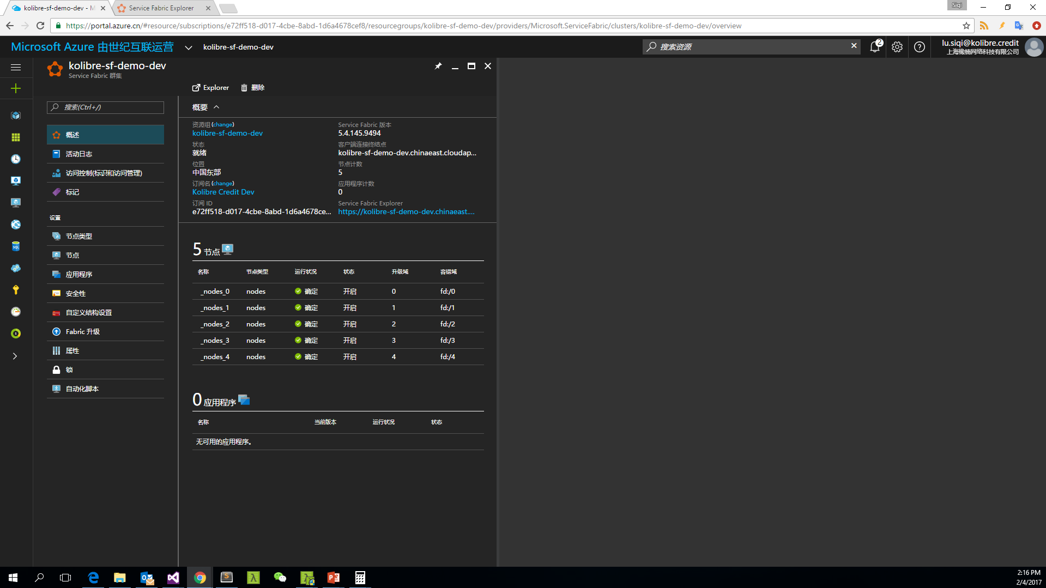

Slide 20
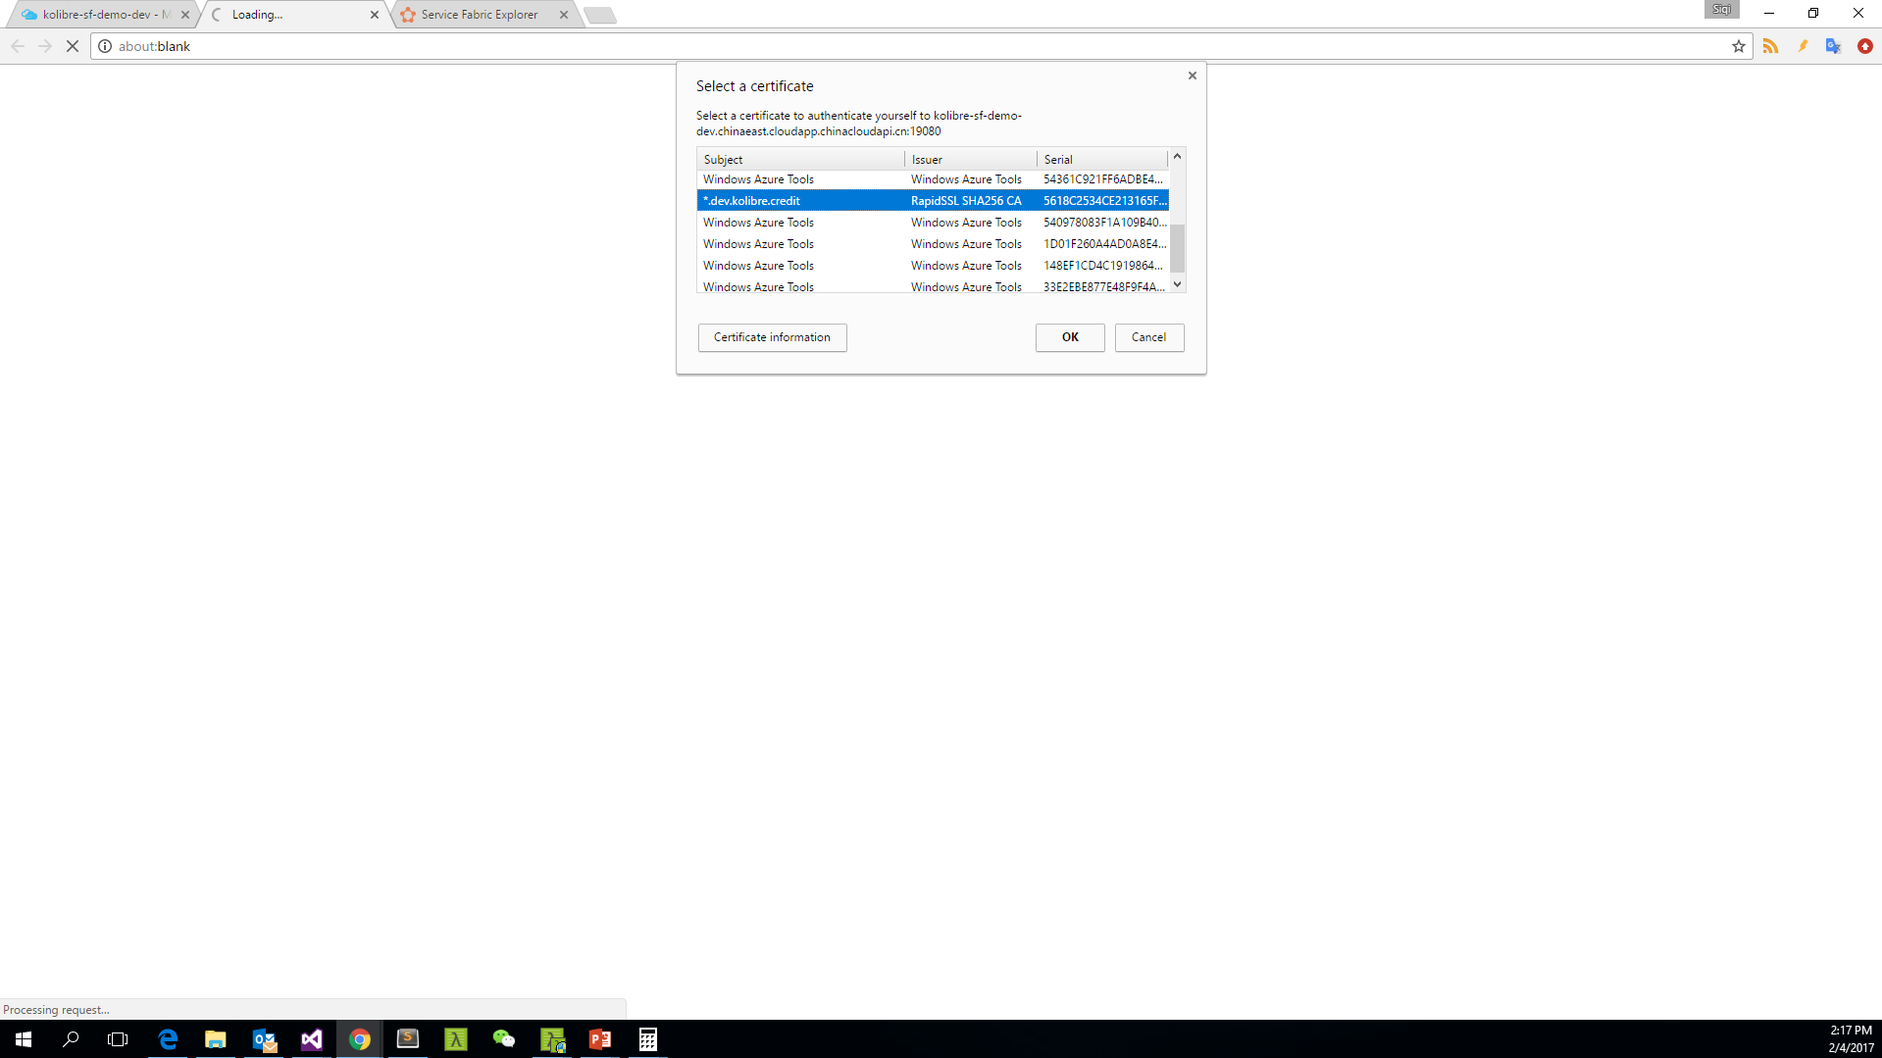

Slide 21
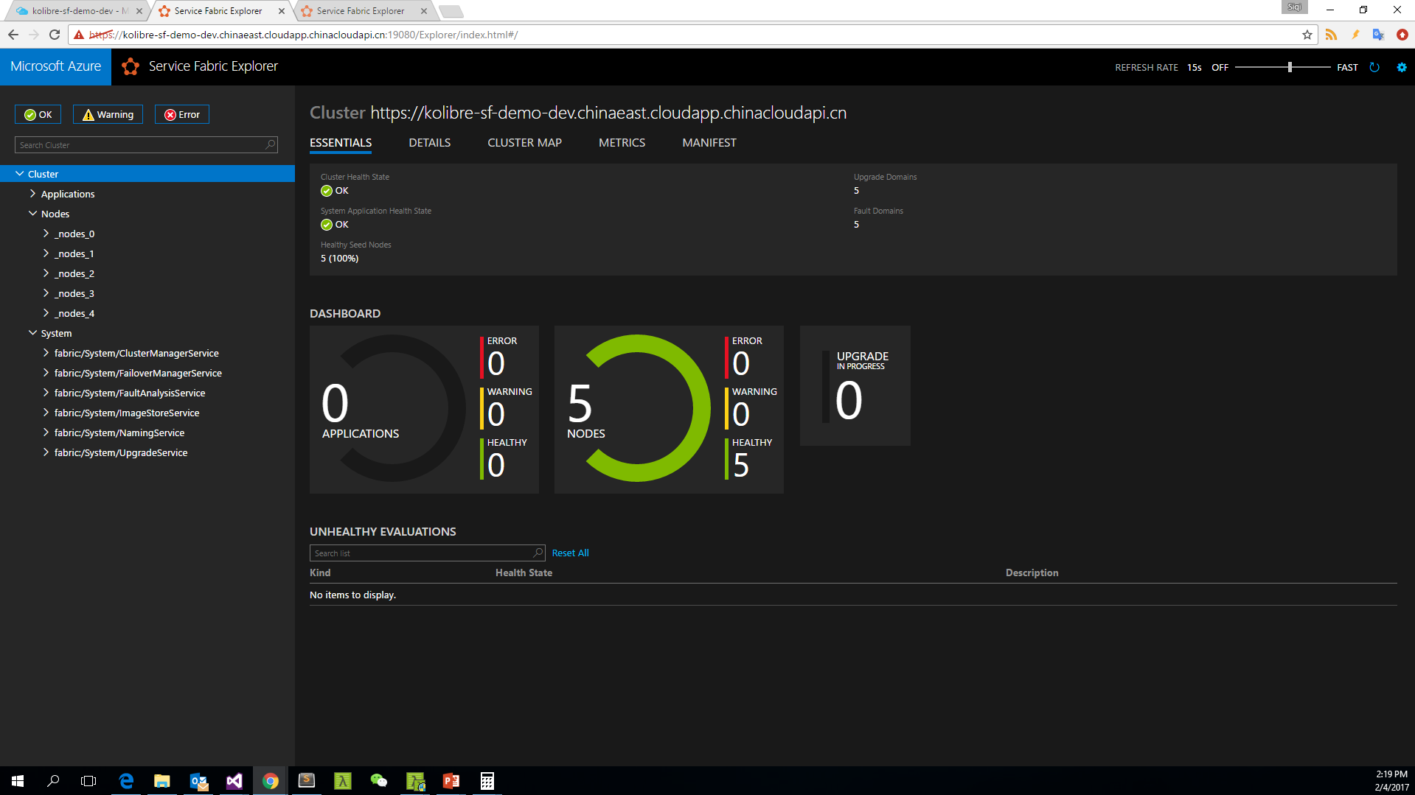

Slide 22
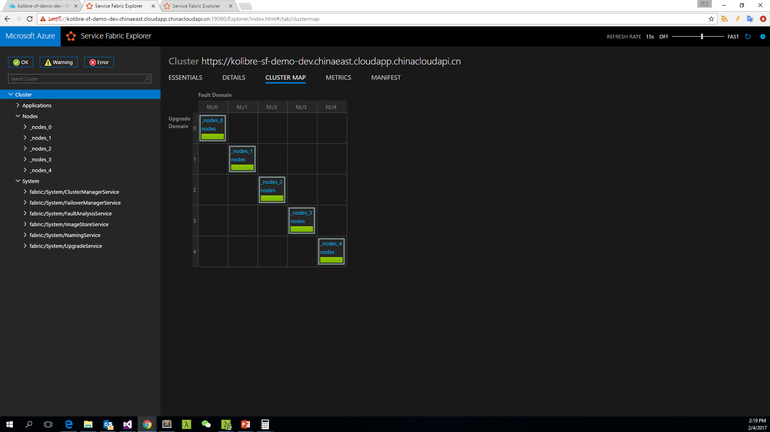

Slide 23
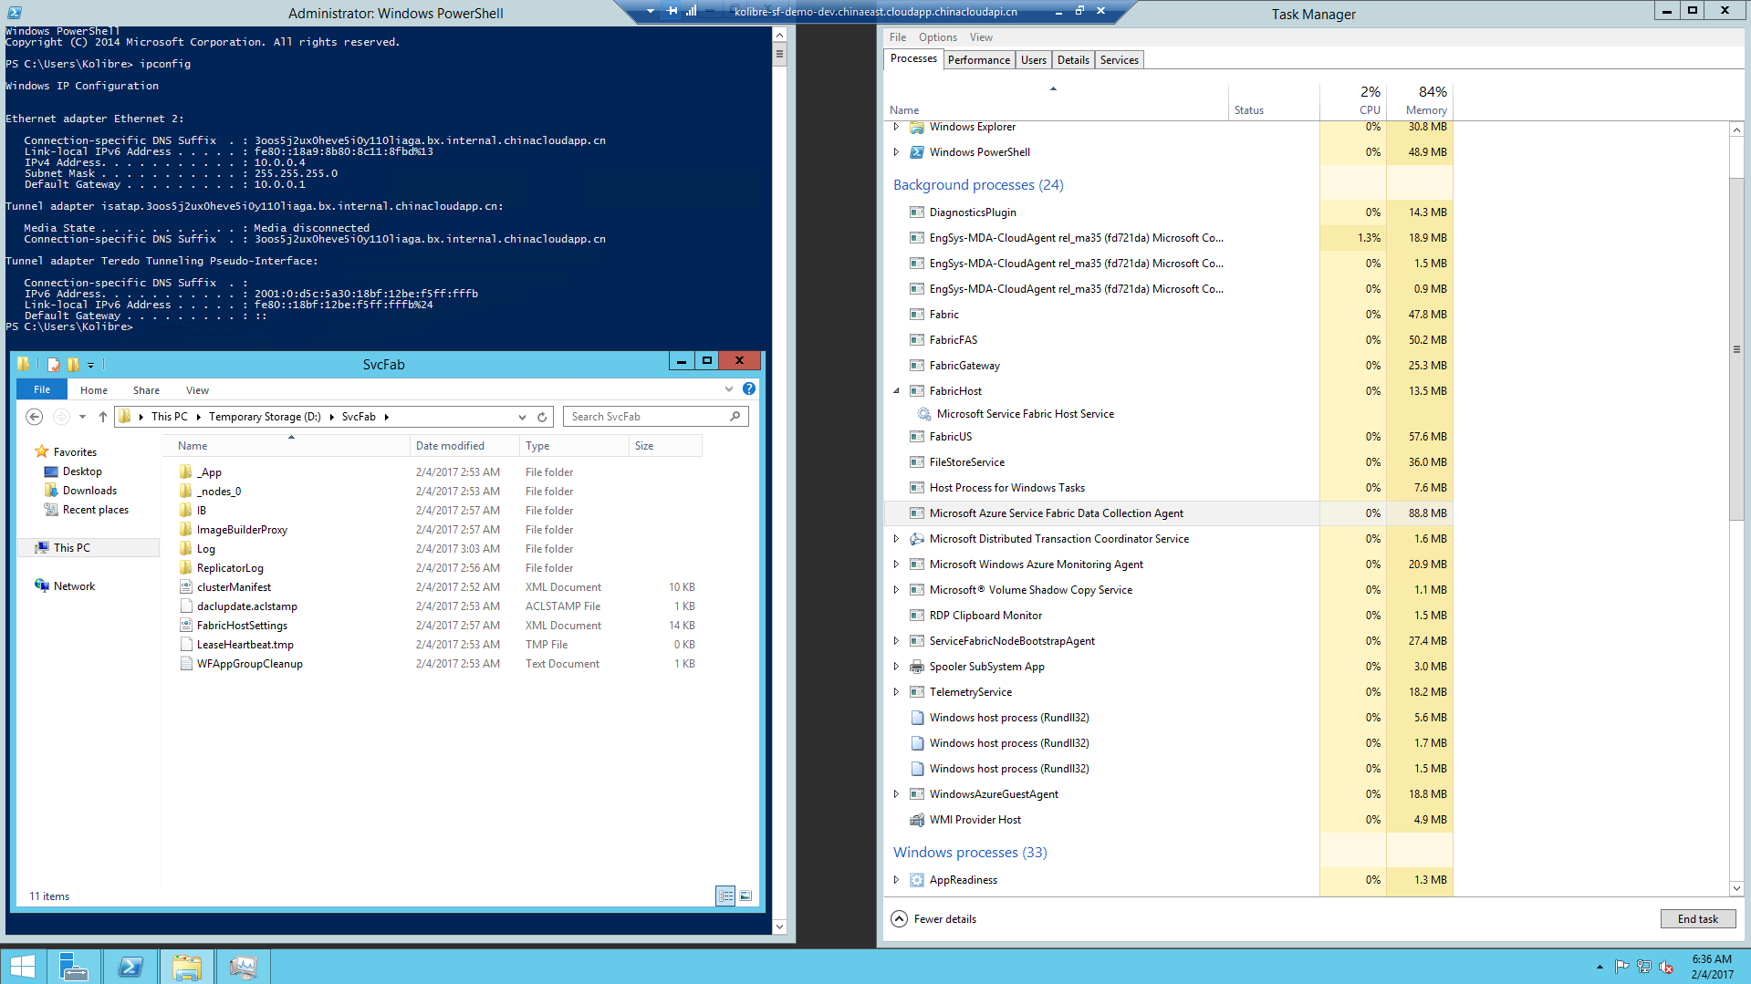

Slide 24
Service type
Services types are composed of code/config/data packages
Code packages define an entry point (dll or exe)
Config packages define service specific config information
Data packages define static resources (eg. images)
Packages can be independently versioned
<ServiceManifest Name="QueueService" Version="1.0">
<ServiceTypes>
<StatefulServiceType ServiceTypeName="QueueServiceType" HasPersistedState="true" />
</ServiceTypes>
<CodePackage Name="Code" Version="1.0">
<EntryPoint>
<ExeHost>
<Program>ServiceHost.exe</Program>
</ExeHost>
</EntryPoint>
</CodePackage>
<ConfigPackage Name="Config" Version="1.0" />
<DataPackage Name="Data" Version="1.0" />
</ServiceManifest>
Service Type 1
Code
Config
Data

Slide 25
Application type
Declarative template for creating an application
Based on a set of service types
Used for packaging, deployment, and versioning
Application Type A
Service Type 1
Service Type 2
Service Type 3
Code
Config
Data
Code
Config
Data
Code
Config
Data

Slide 26
Service Fabric Microservices
App1
App2
App Type Packages
Service Fabric Cluster VMs

Slide 27
Service Fabric Programming Models

Slide 28
Service Fabric Programming Models
Guest Executables
Bring any exe
Any language
Any programming model
Packaged as Application
Gets versioning, upgrade, monitoring, health, etc.
Reliable Services
Stateless & stateful services
Concurrent, granular state changes
Use of the Reliable Collections
Transactions across collections
Full platform integration
Reliable Actors
Stateless & stateful actor objects
Simplified programming model
Single Threaded model
Great for scaled out compute and state

Slide 29
Stateless Reliable Service
No state or stores state externally
Used to host web front end (Asp.Net Web API) or simple biz service
Only Instance; DO NOT USE Partition and Replica
Instance A
Load Balancer
Instance B
Instance C
Notes:
负载均衡机制和一般的网络应用相同

Slide 30
Demo
Stateless Reliable Service
Stateless Service Application
Availability
Scalability
Notes:
Service Fabric 需要在64位环境下工作，并且暂时不支持 .net Core
在只有一个实例的情况下演示 InstanceId 的正确性和 Availability，同时简单体验 Service Fabric Explorer 中的测试功能和客户端的重试机制（需要解释超时机制和ExceptionHandler机制）
在本地展示同时拥有3个和5个实例的情况，说明 Availability 和 Scalability 特性，修改部署参数需要重新部署，解释可重试错误和不可重试错误的区别
在 Azure 上演示 Scalability

Slide 31
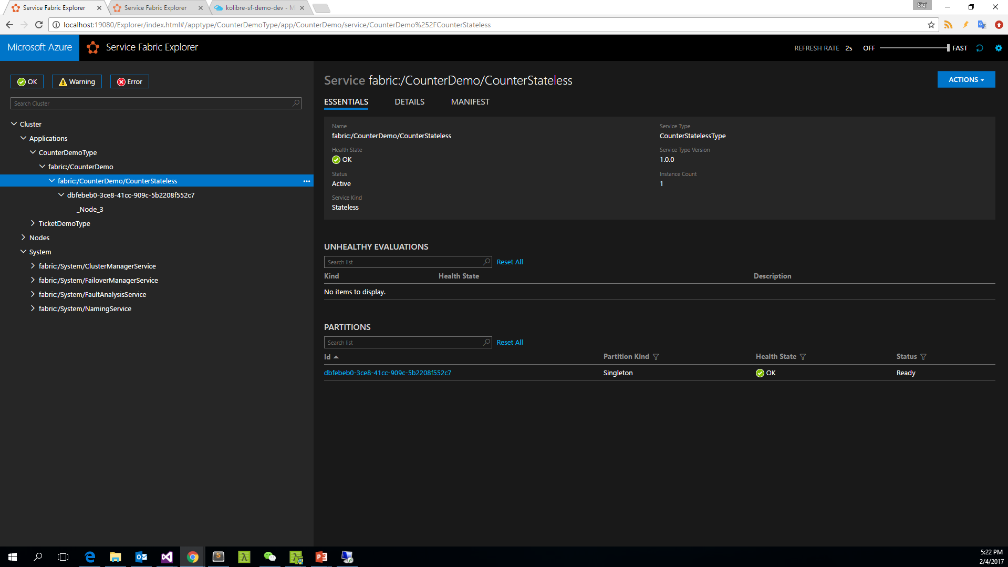

Slide 32
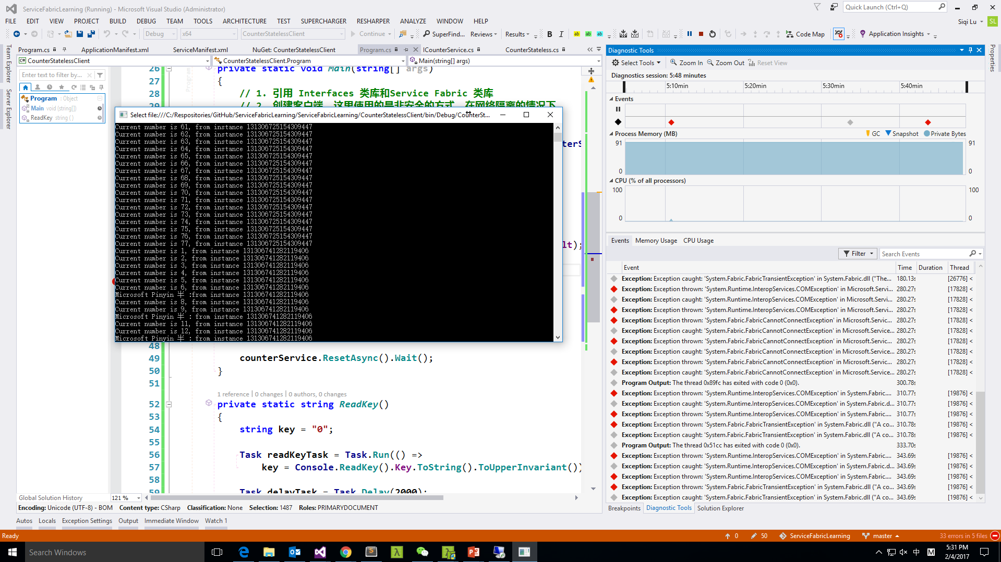
Notes:
自动更换部署节点

Slide 33
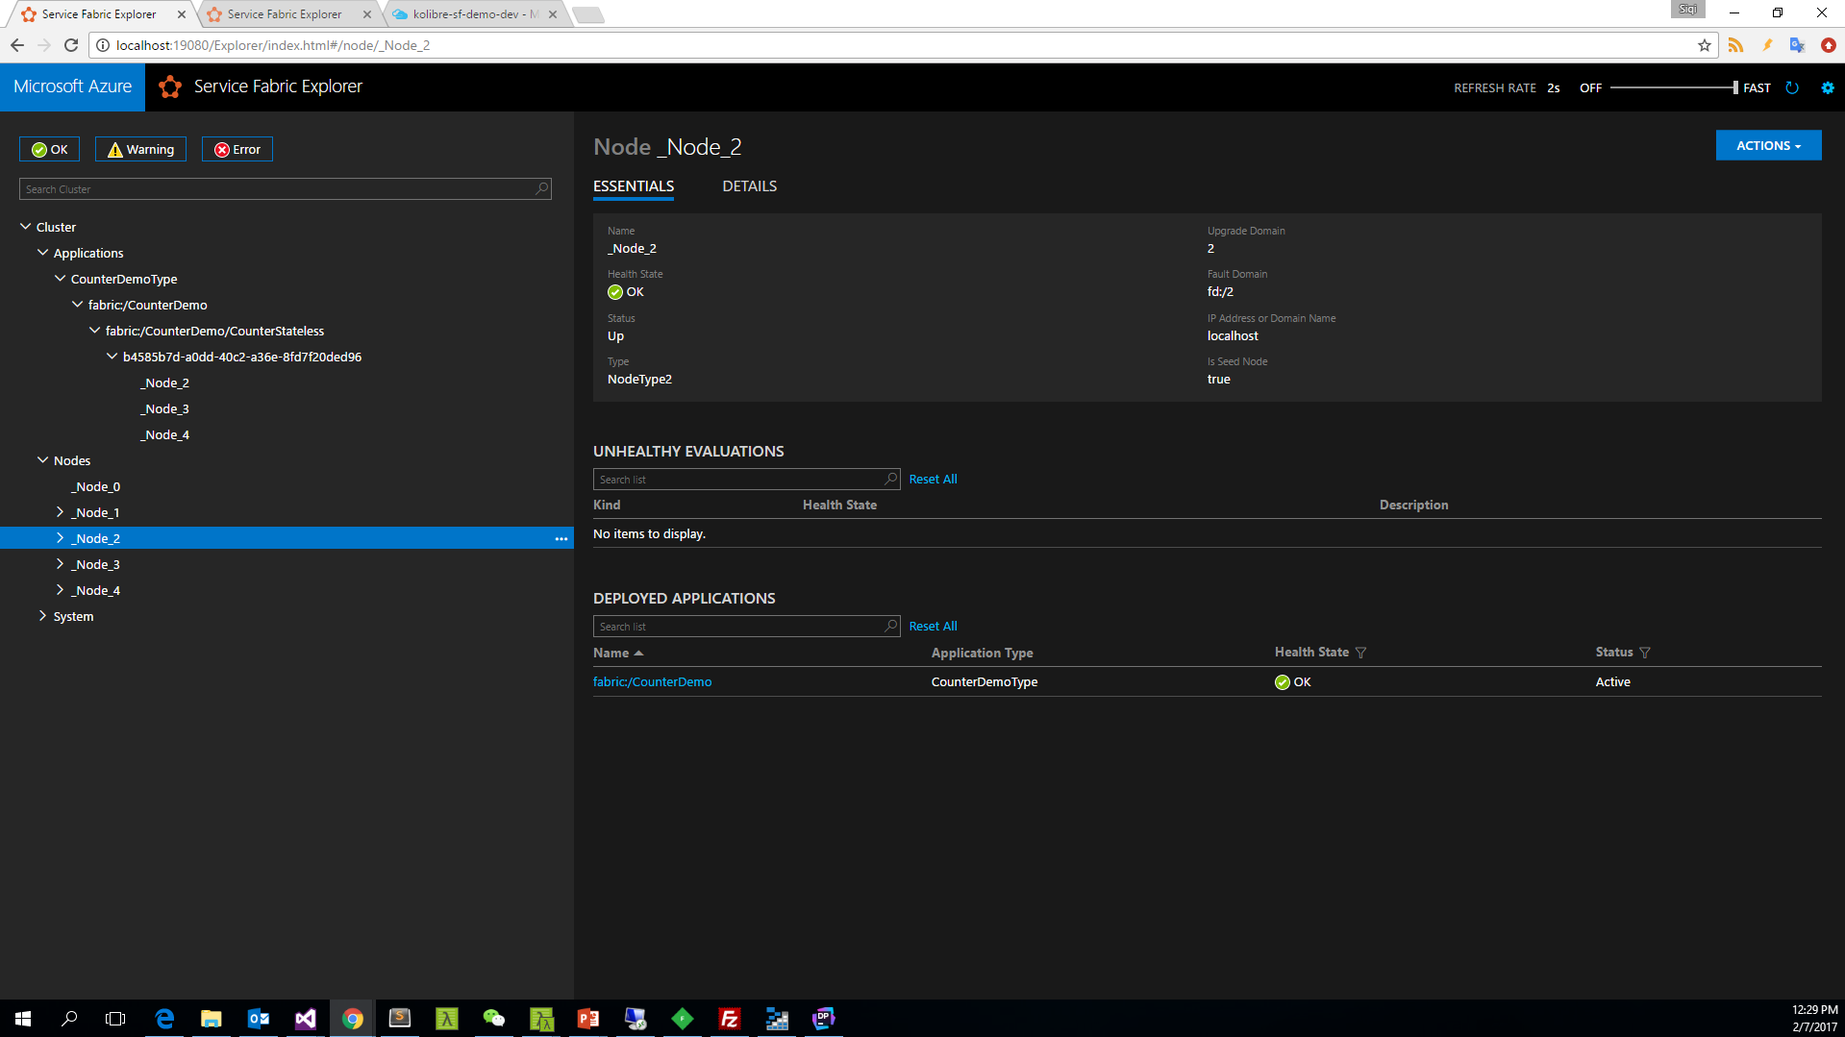
Notes:
在本地使用3个节点部署应用

Slide 34
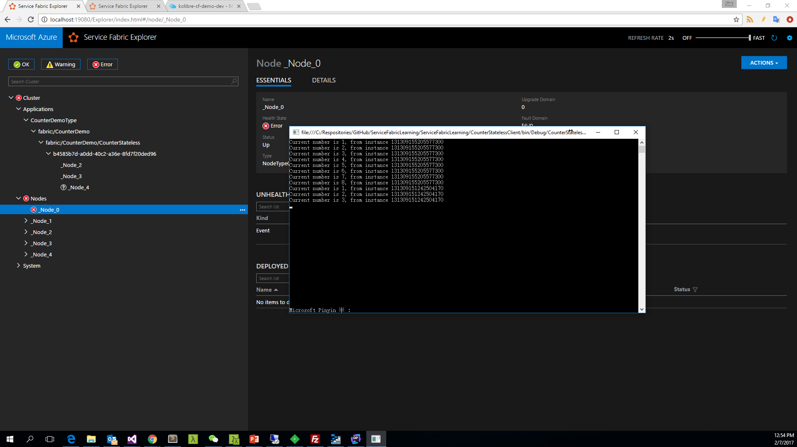
Notes:
服务自动切换到正常工作的节点

Slide 35
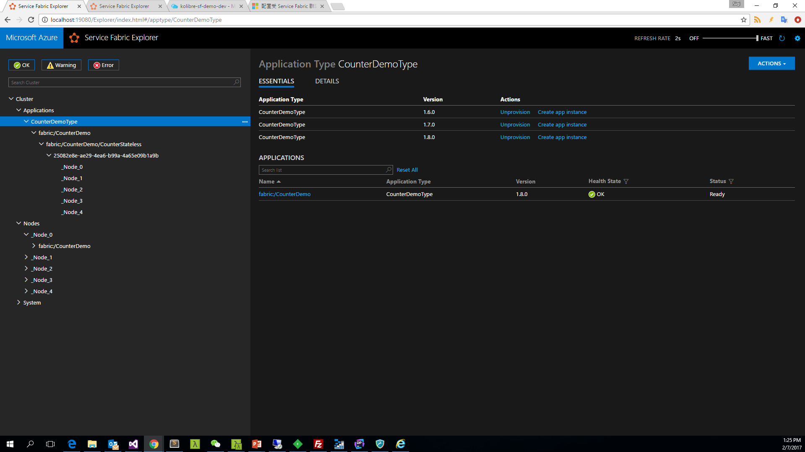
Notes:
在本地使用5个节点部署应用

Slide 36
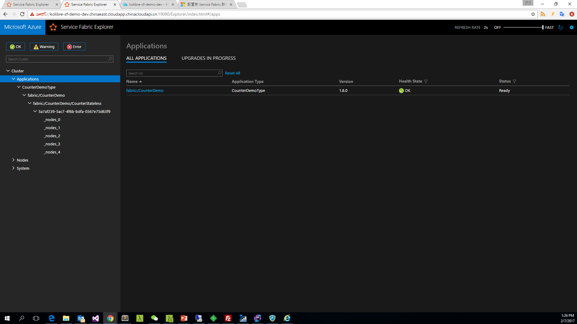
Notes:
在Azure上部署5个节点，并且进行伸缩
通过PowerShell伸缩为7个节点
$resource = Get-AzureRmResource -ResourceGroupName $resourceGroup.ResourceGroupName -ResourceType Microsoft.Compute/VirtualMachineScaleSets
$vmss = Get-AzureRmVmss -ResourceGroupName $resourceGroup.ResourceGroupName -VMScaleSetName $resource.Name
$vmss.Sku.Capacity = 7
Update-AzureRmVmss -ResourceGroupName $resourceGroup.ResourceGroupName -Name $vmss.Name -VirtualMachineScaleSet $vmss
通过PowerShell伸缩为5个节点

Slide 37
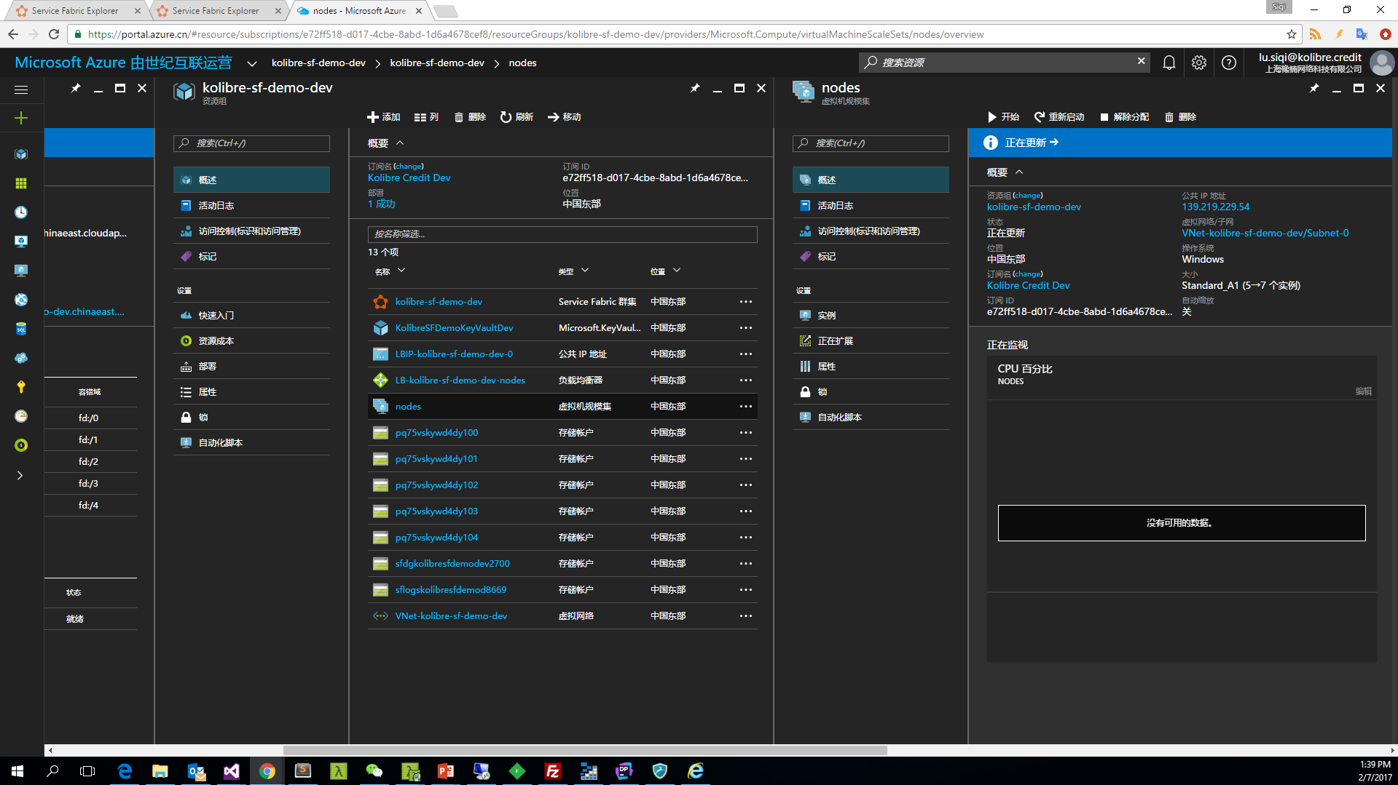
Notes:
在Azure上部署5个节点，并且进行伸缩
通过PowerShell伸缩为7个节点
$resource = Get-AzureRmResource -ResourceGroupName $resourceGroup.ResourceGroupName -ResourceType Microsoft.Compute/VirtualMachineScaleSets
$vmss = Get-AzureRmVmss -ResourceGroupName $resourceGroup.ResourceGroupName -VMScaleSetName $resource.Name
$vmss.Sku.Capacity = 7
Update-AzureRmVmss -ResourceGroupName $resourceGroup.ResourceGroupName -Name $vmss.Name -VirtualMachineScaleSet $vmss
通过PowerShell伸缩为5个节点
$vmss.Sku.Capacity = 5
Update-AzureRmVmss -ResourceGroupName $resourceGroup.ResourceGroupName -Name $vmss.Name -VirtualMachineScaleSet $vmss

Slide 38
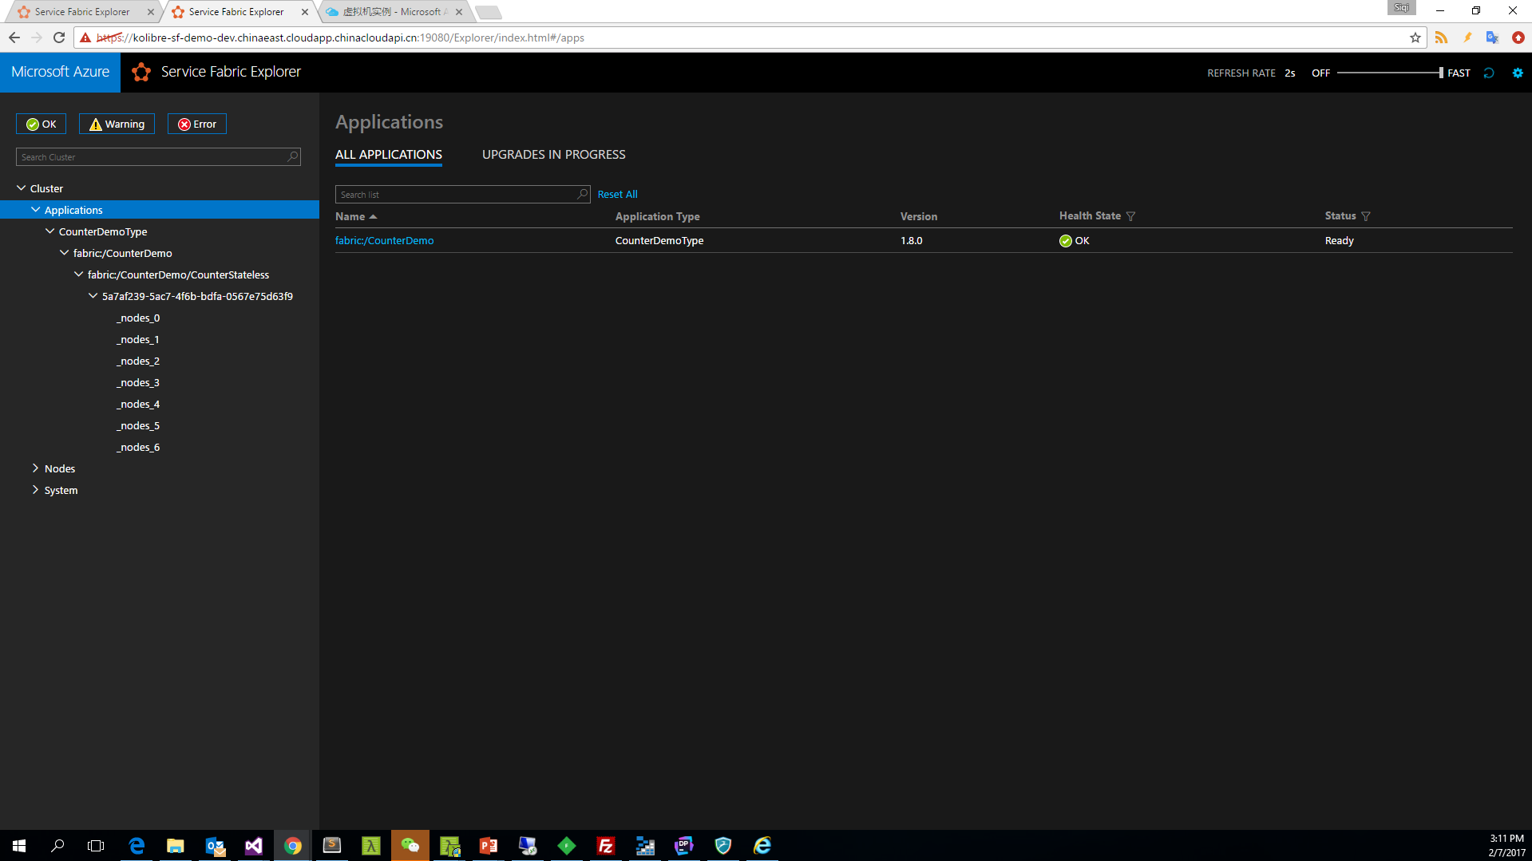
Notes:
在Azure上部署5个节点，并且进行伸缩
通过PowerShell伸缩为7个节点
$resource = Get-AzureRmResource -ResourceGroupName $resourceGroup.ResourceGroupName -ResourceType Microsoft.Compute/VirtualMachineScaleSets
$vmss = Get-AzureRmVmss -ResourceGroupName $resourceGroup.ResourceGroupName -VMScaleSetName $resource.Name
$vmss.Sku.Capacity = 7
Update-AzureRmVmss -ResourceGroupName $resourceGroup.ResourceGroupName -Name $vmss.Name -VirtualMachineScaleSet $vmss
通过PowerShell伸缩为5个节点
$vmss.Sku.Capacity = 5
Update-AzureRmVmss -ResourceGroupName $resourceGroup.ResourceGroupName -Name $vmss.Name -VirtualMachineScaleSet $vmss

Slide 39
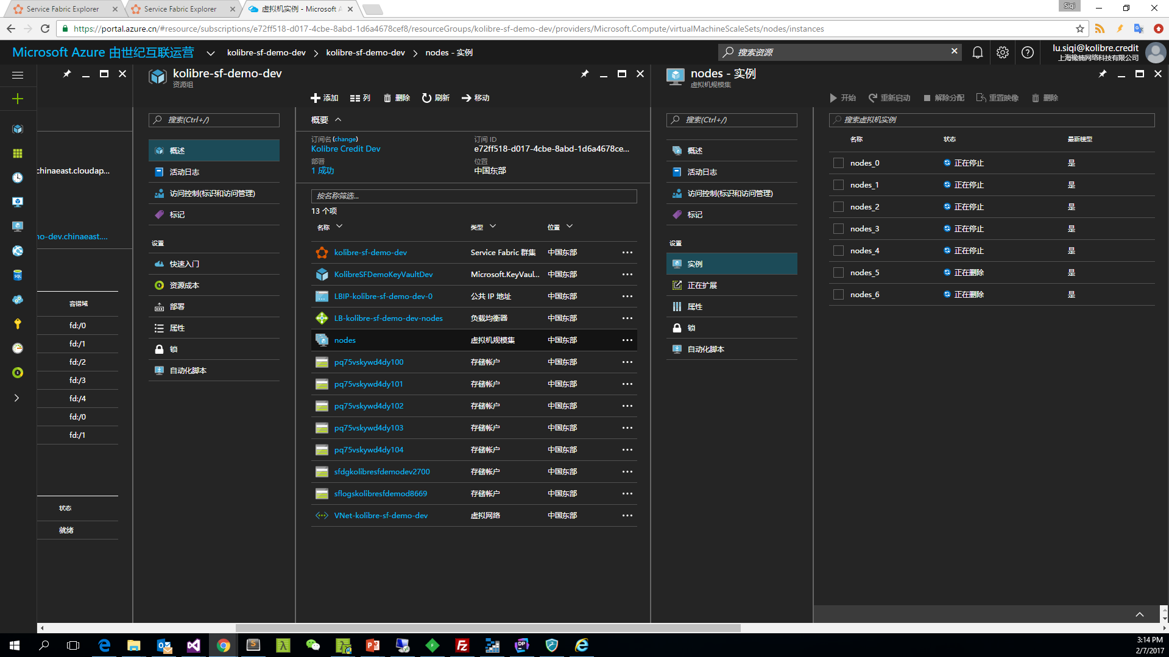
Notes:
在Azure上部署5个节点，并且进行伸缩
通过PowerShell伸缩为7个节点
$resource = Get-AzureRmResource -ResourceGroupName $resourceGroup.ResourceGroupName -ResourceType Microsoft.Compute/VirtualMachineScaleSets
$vmss = Get-AzureRmVmss -ResourceGroupName $resourceGroup.ResourceGroupName -VMScaleSetName $resource.Name
$vmss.Sku.Capacity = 7
Update-AzureRmVmss -ResourceGroupName $resourceGroup.ResourceGroupName -Name $vmss.Name -VirtualMachineScaleSet $vmss
通过PowerShell伸缩为5个节点
$vmss.Sku.Capacity = 5
Update-AzureRmVmss -ResourceGroupName $resourceGroup.ResourceGroupName -Name $vmss.Name -VirtualMachineScaleSet $vmss

Slide 40
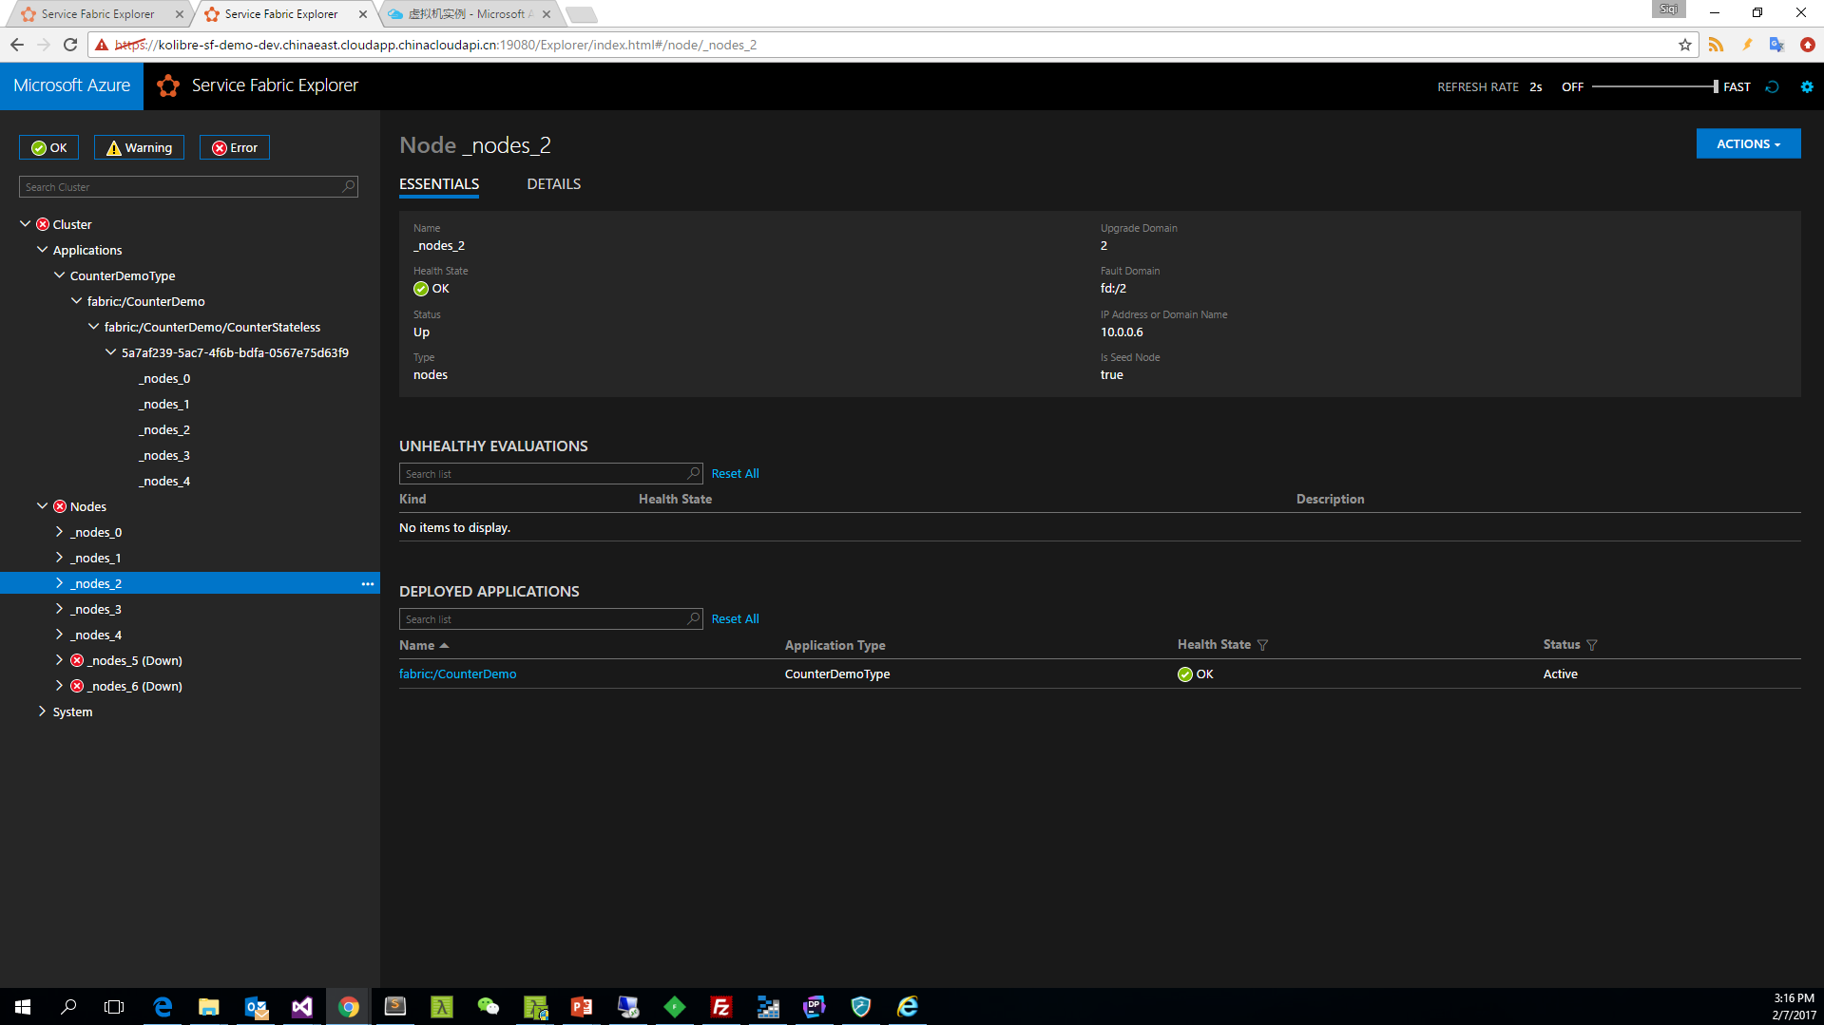
Notes:
在Azure上部署5个节点，并且进行伸缩
通过PowerShell伸缩为7个节点
$resource = Get-AzureRmResource -ResourceGroupName $resourceGroup.ResourceGroupName -ResourceType Microsoft.Compute/VirtualMachineScaleSets
$vmss = Get-AzureRmVmss -ResourceGroupName $resourceGroup.ResourceGroupName -VMScaleSetName $resource.Name
$vmss.Sku.Capacity = 7
Update-AzureRmVmss -ResourceGroupName $resourceGroup.ResourceGroupName -Name $vmss.Name -VirtualMachineScaleSet $vmss
通过PowerShell伸缩为5个节点
$vmss.Sku.Capacity = 5
Update-AzureRmVmss -ResourceGroupName $resourceGroup.ResourceGroupName -Name $vmss.Name -VirtualMachineScaleSet $vmss

Slide 41
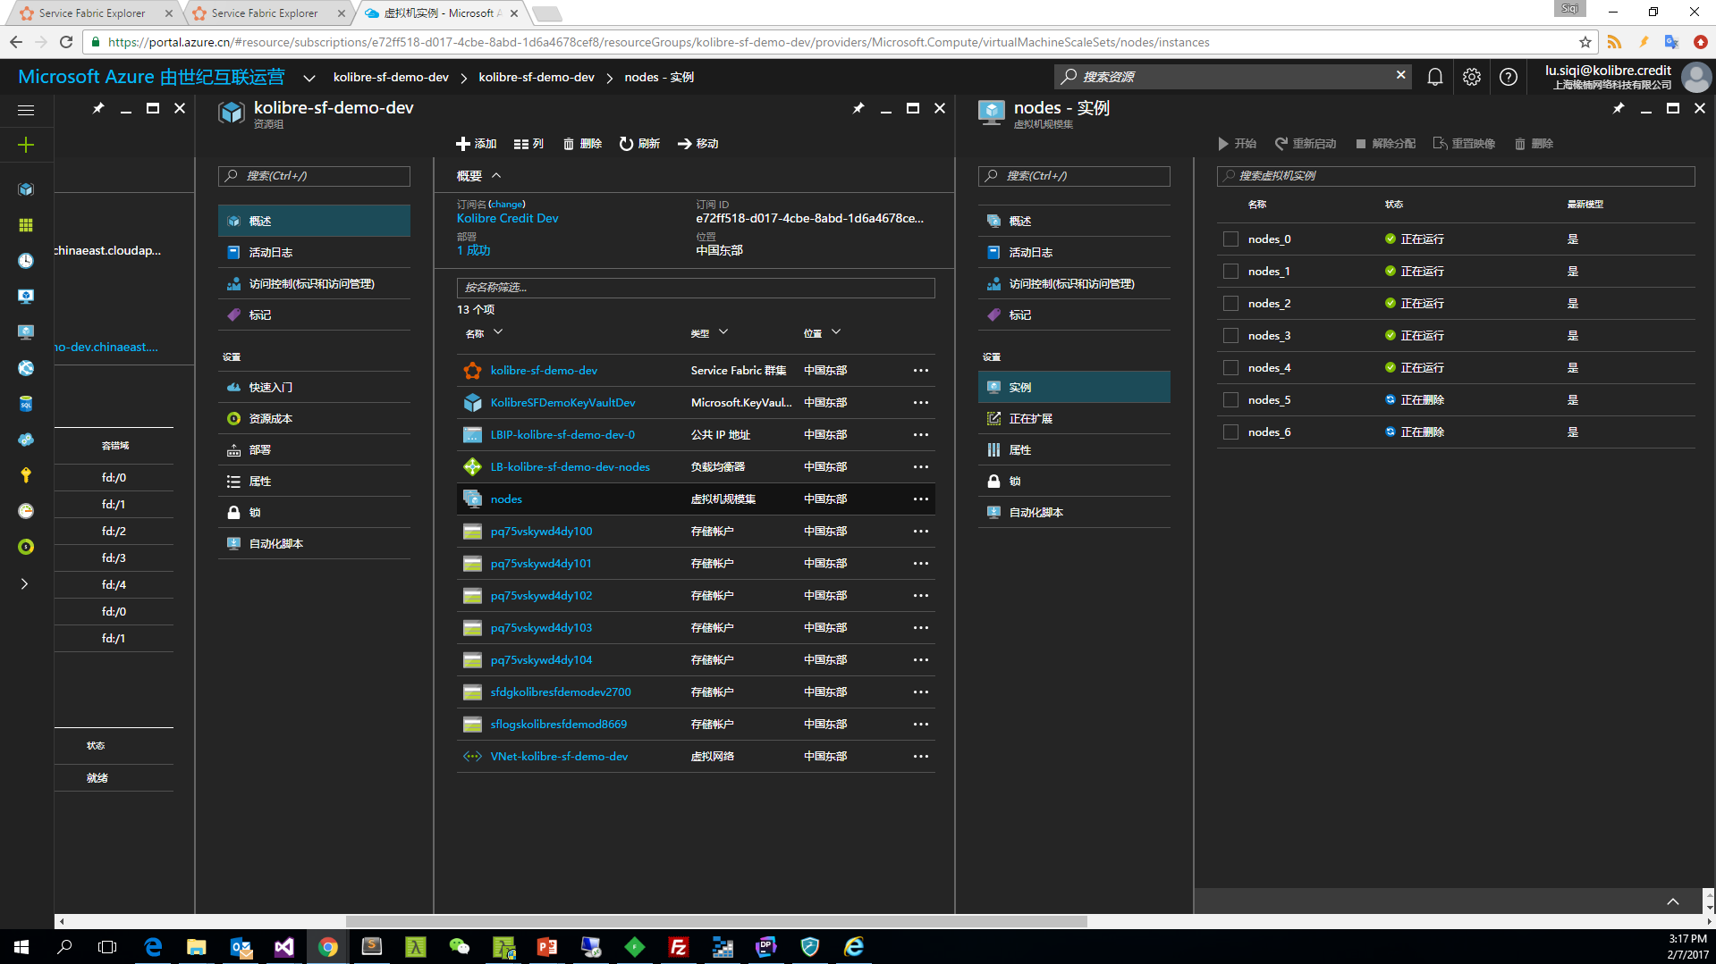
Notes:
在Azure上部署5个节点，并且进行伸缩
通过PowerShell伸缩为7个节点
$resource = Get-AzureRmResource -ResourceGroupName $resourceGroup.ResourceGroupName -ResourceType Microsoft.Compute/VirtualMachineScaleSets
$vmss = Get-AzureRmVmss -ResourceGroupName $resourceGroup.ResourceGroupName -VMScaleSetName $resource.Name
$vmss.Sku.Capacity = 7
Update-AzureRmVmss -ResourceGroupName $resourceGroup.ResourceGroupName -Name $vmss.Name -VirtualMachineScaleSet $vmss
通过PowerShell伸缩为5个节点
$vmss.Sku.Capacity = 5
Update-AzureRmVmss -ResourceGroupName $resourceGroup.ResourceGroupName -Name $vmss.Name -VirtualMachineScaleSet $vmss

Slide 42
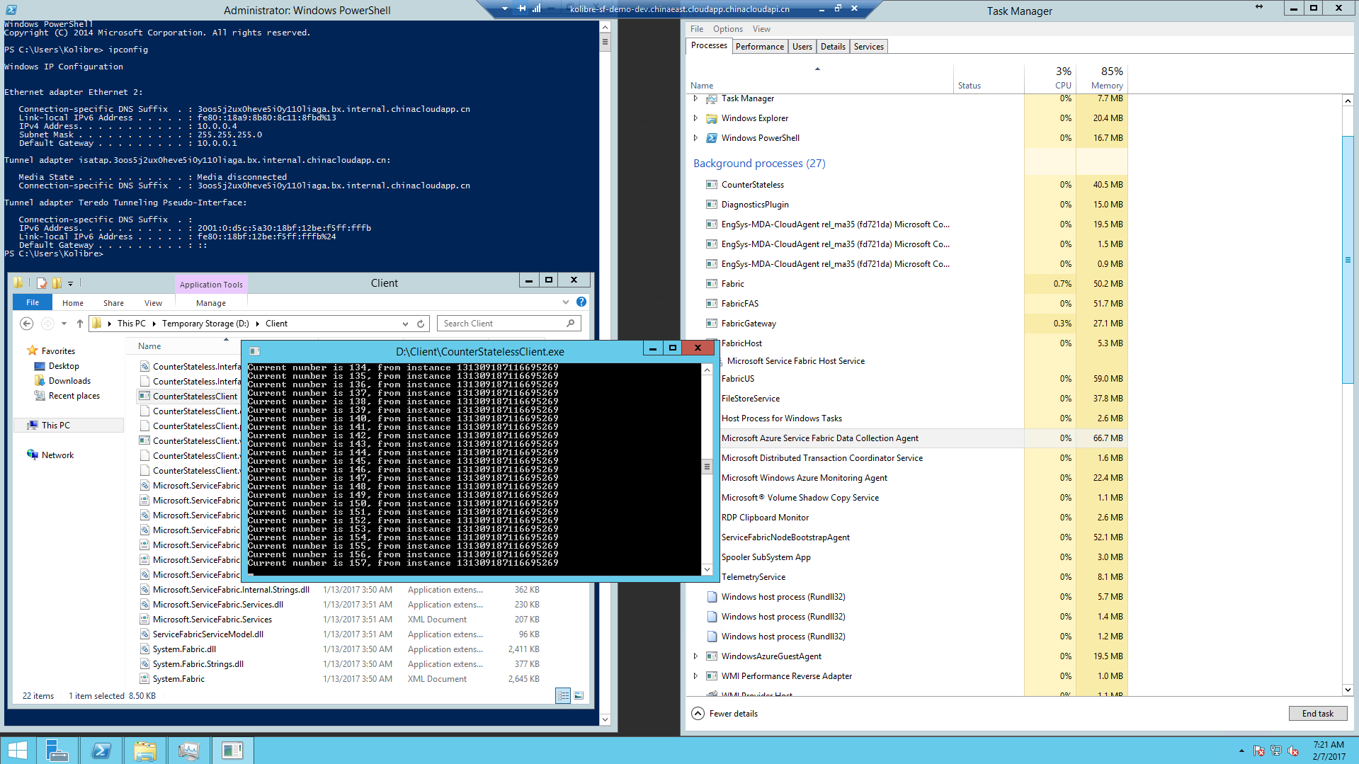
Notes:
尝试在本地调用服务

Slide 43
Stateful Reliable Service
Has state and stores state internally
Used to simple biz service(hosting actor service)
Partition and Replica; IGNORE Instance
Collections
Single machine
Single-threaded
Concurrent Collections
Single machine
Multi-threaded
Reliable Collections
Multi-machine
Replicated (HA)
Persistence (durable)
Asynchronous
Transactional

Slide 44
Transactionally Modifying Reliable Data
protected override async Task RunAsync(CancellationToken cancellationToke)
{
var requestQueue = await this.StateManager.GetOrAddAsync<IReliableQueue<CustomerRecord>>(“requests");
var locationDictionary = await this.StateManager.GetOrAddAsync<IReliableDictionary<Guid, LocationInfo>>(“locs");
var personDictionary = await this.StateManager.GetOrAddAsync<IReliableDictionary<Guid, Person>>(“ppl");
var customerListDictionary = await this.StateManager.GetOrAddAsync<IReliableDictionary<Guid, object>>(“customers");
while (true)
{
cancellationToke.ThrowIfCancellationRequested();
Guid customerId = Guid.NewGuid();
using (var tx = this.StateManager.CreateTransaction())
{
var customerRequestResult = await requestQueue.TryDequeueAsync(tx);
await customerListDictionary.AddAsync(tx, customerId, new object());
await personDictionary.AddAsync(tx, customerId, customerRequestResult.Value.person);
await locationDictionary.AddAsync(tx, customerId, customerRequestResult.Value.locInfo);
await tx.CommitAsync();
}
}
}
Everything happens or nothing happens!

Slide 45
Service partitioning
Services can be partitioned for scale-out.
You can choose your own partitioning scheme.
Service partitions are striped across machines in the cluster.
Replicas automatically scale out & in on cluster changes
Node 1
Node 2
Node 3
Node 4
Node 5
Node 6
S
P2
P1
S
S
S
S
P3
P4
S
S
S

Slide 46
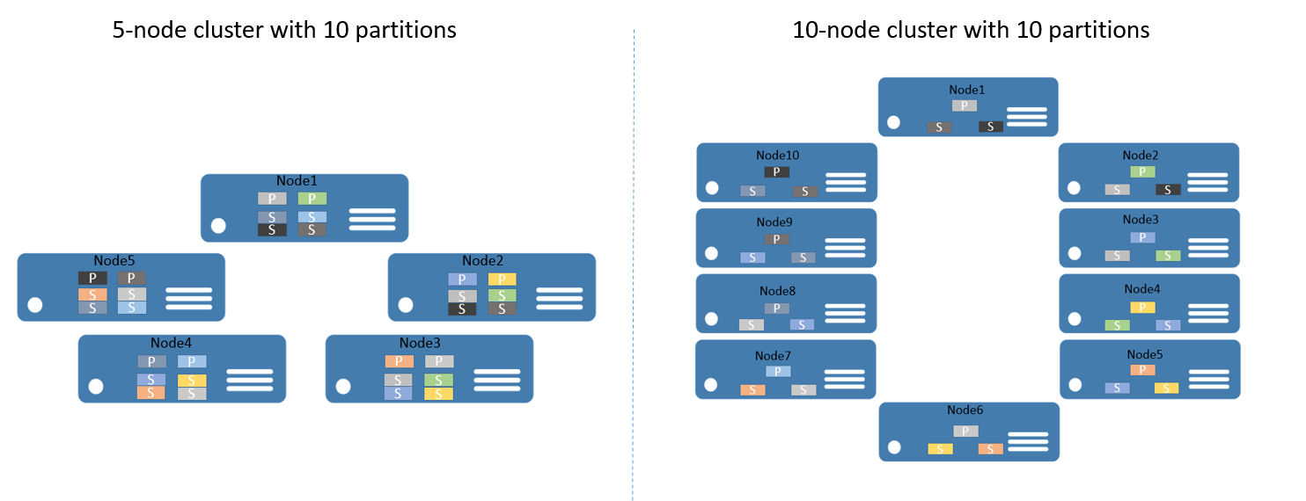
Service partitioning

Slide 47
Stateful Microservices - Replication
Primary
Secondary
Replication
Service Fabric Cluster VMs

Slide 48
Service Fabric Microservices
App1
App2
App Type Packages
Service Fabric Cluster VMs

Slide 49
Handling Machine Failures
#FAIL
App1
App2
App Type Packages
Service Fabric Cluster VMs

Slide 50
Demo
Stateful Reliable Service
Stateful Service Application
Partition
Availability
Scalability

Slide 51
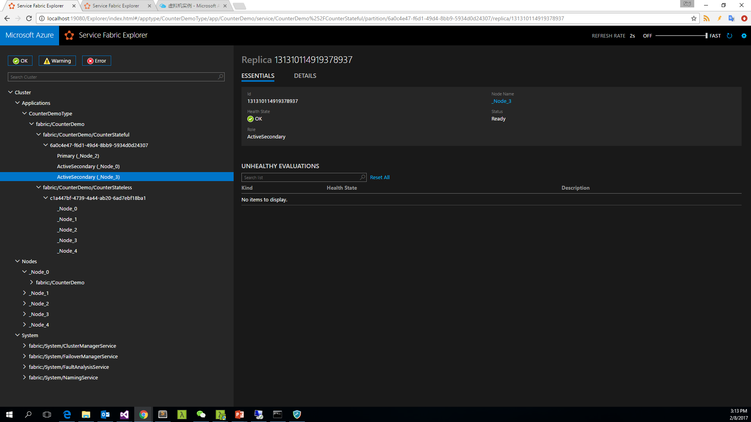
Notes:
PartitionCount
MinReplicaSetSize
TargetReplicaSetSize

Slide 52
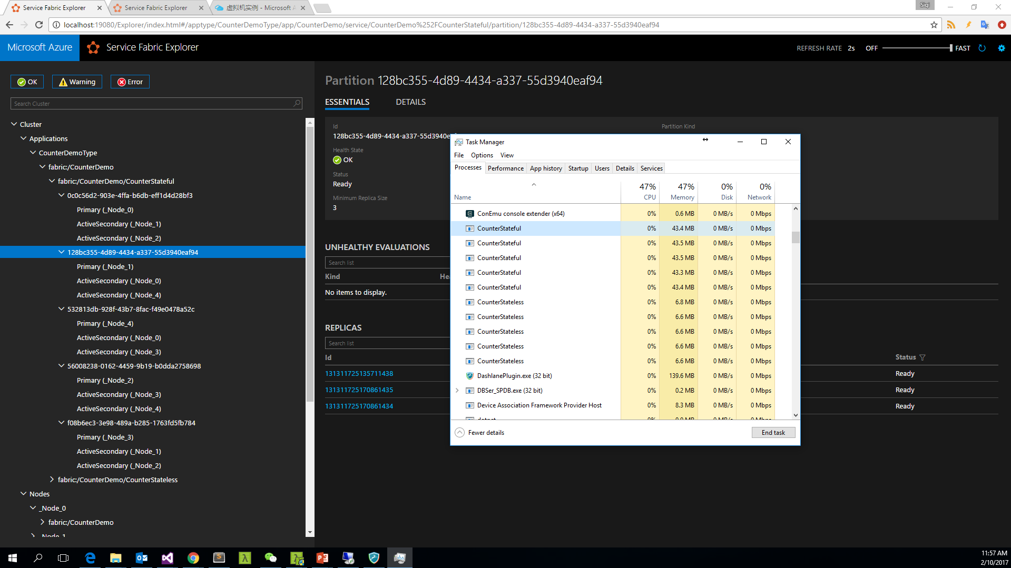
Notes:
有可能 ActiveSecondary 同时是2个 Partition 的 Replica，另外 Replica 的 Id 可能相同也可能不同，必须要同时使用 PartitionId 和 ReplicaId 才能唯一确定一个逻辑实例

Slide 53
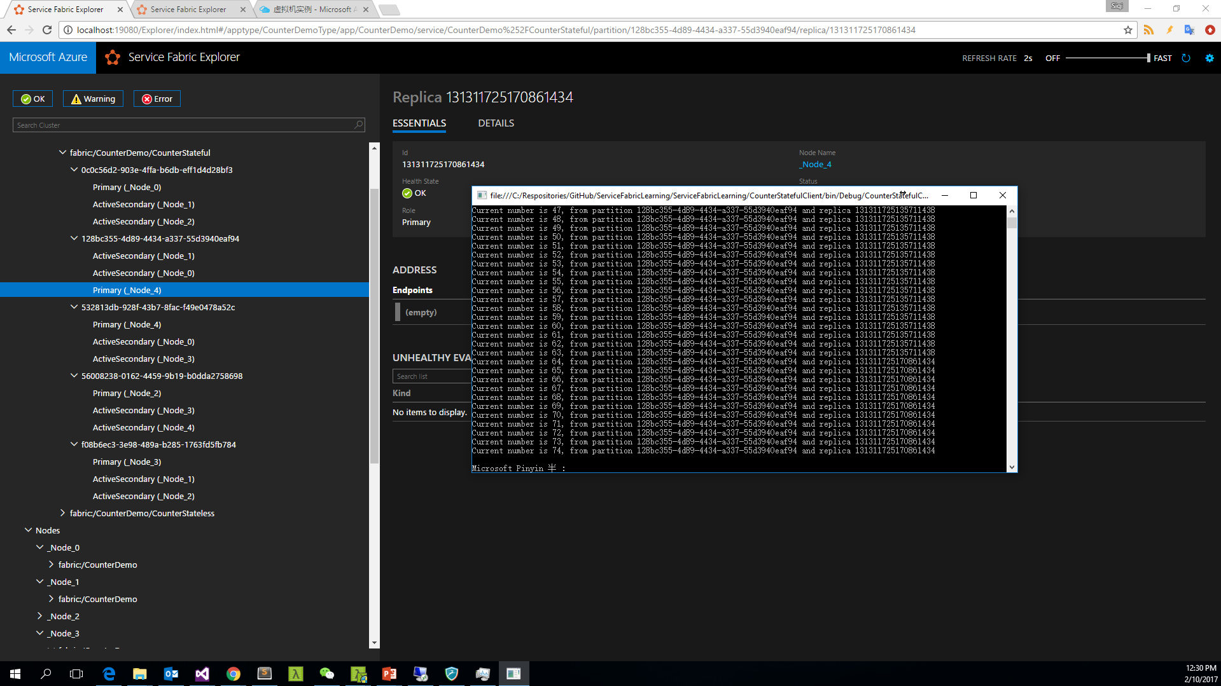
Notes:
Stateful Service 的高可用性是通过每一个 Partition 的多个 Replica 来实现的

Slide 54
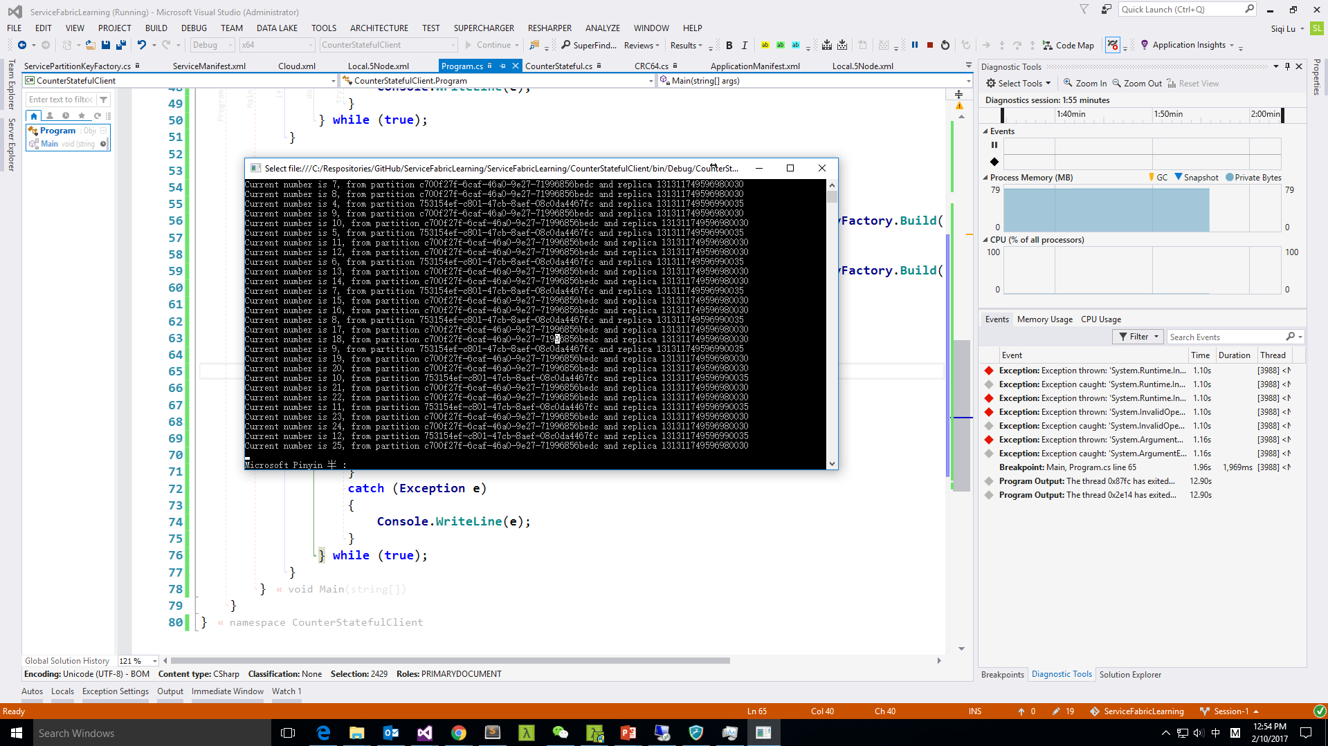
Notes:
不同的 Partition 之间的数据是分区的，不互通也不同步

Slide 55
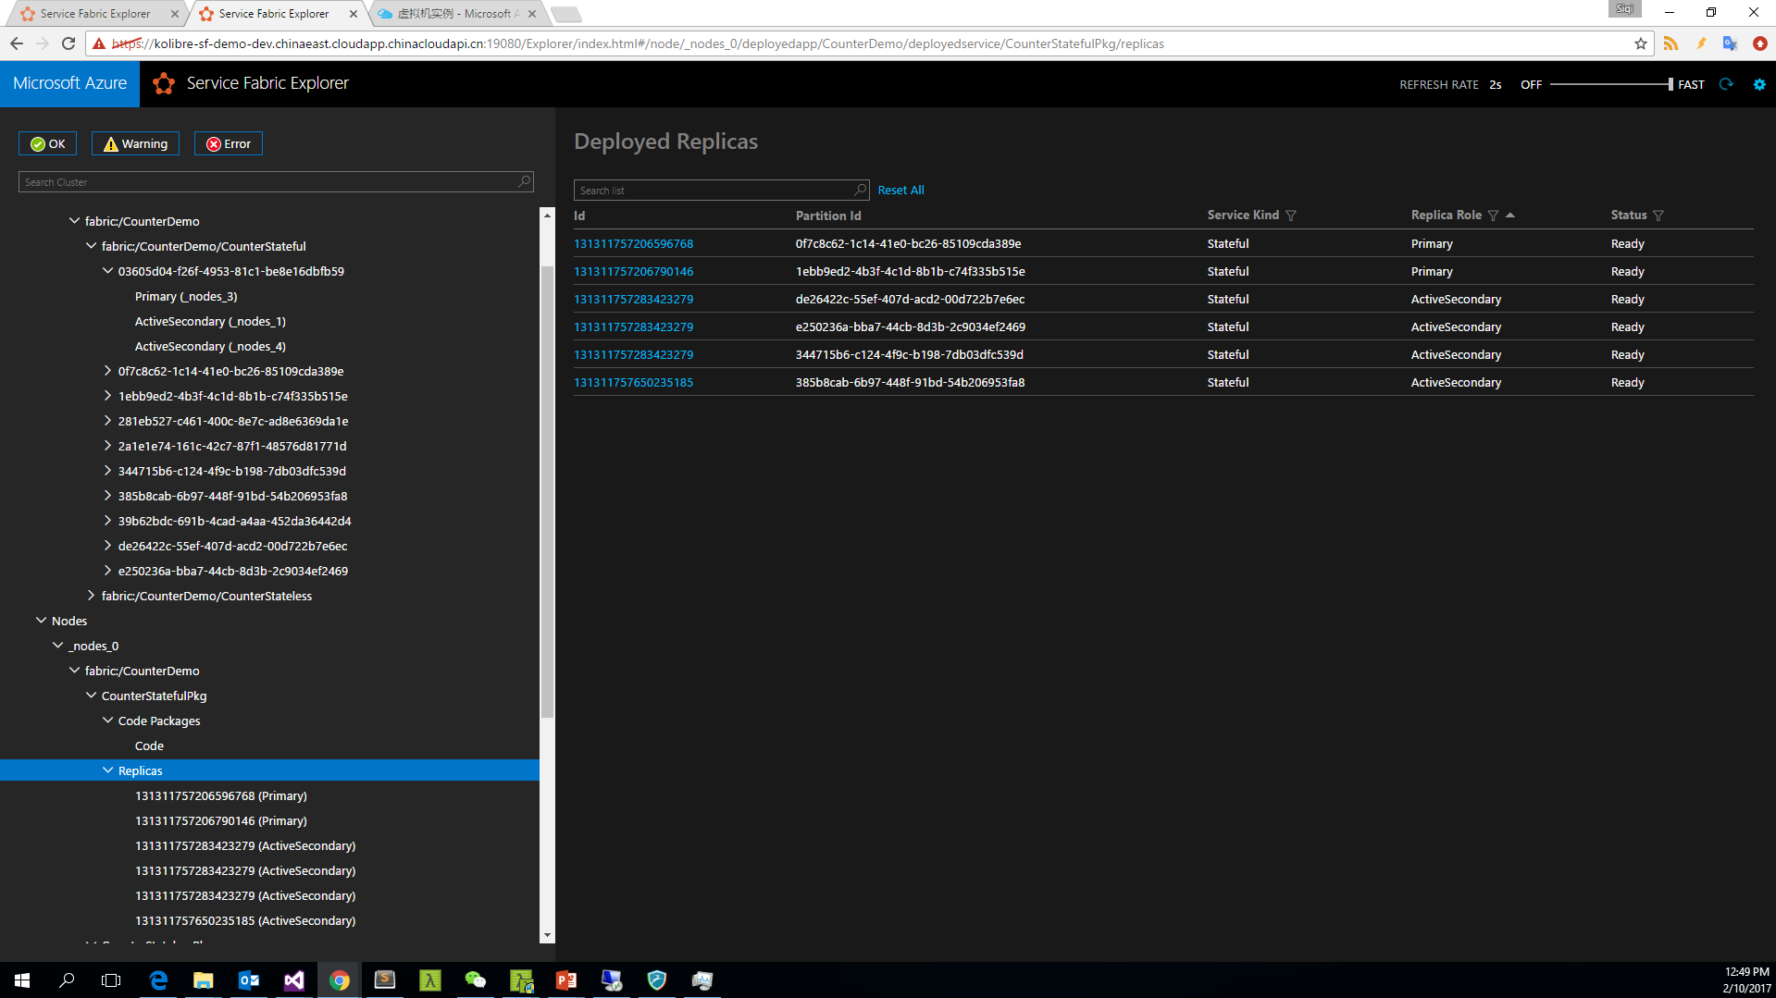
Notes:
Stateful Service 的伸缩性是通过多个 Partition 的虚拟分区机制实现的

Slide 56
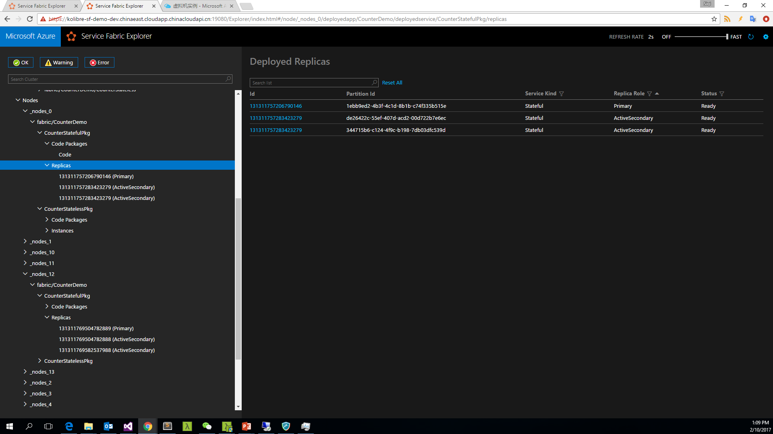
Notes:
Stateful Service 的伸缩性是通过多个 Partition 的虚拟分区机制实现的

Slide 57
Reliable Actors
Reliable Actor is Stateful Service
Turn-based access
Automatically created and dehydrated as necessary
Timer and Reminder
State Management

Slide 58
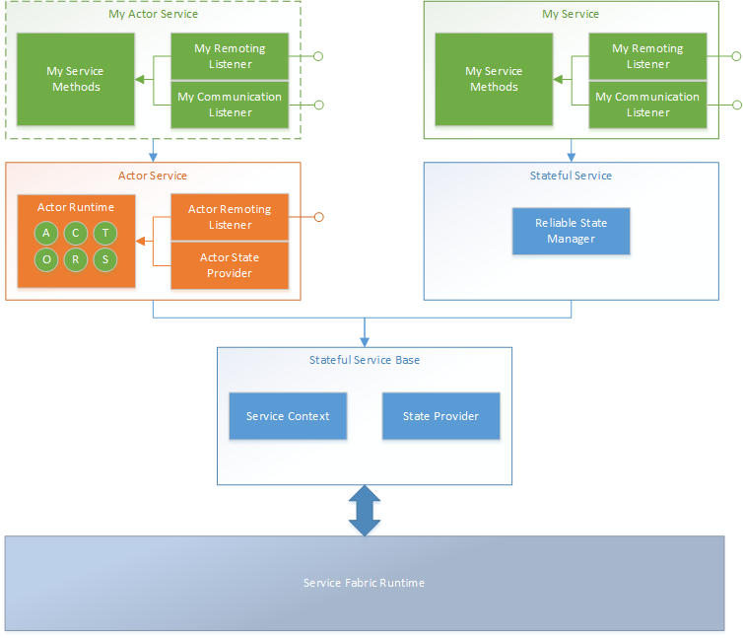
Service Layering

Slide 59
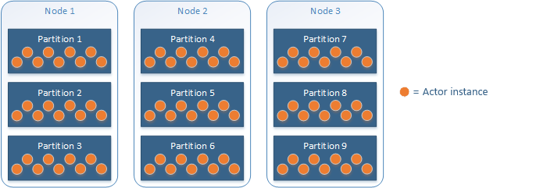
Availability and Scalability

Slide 60
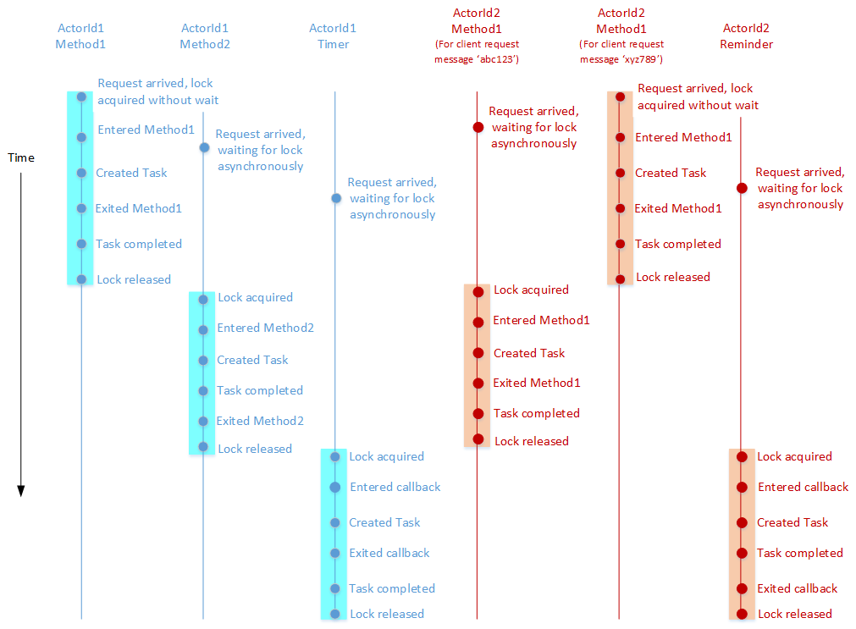
Turn-based access

Slide 61
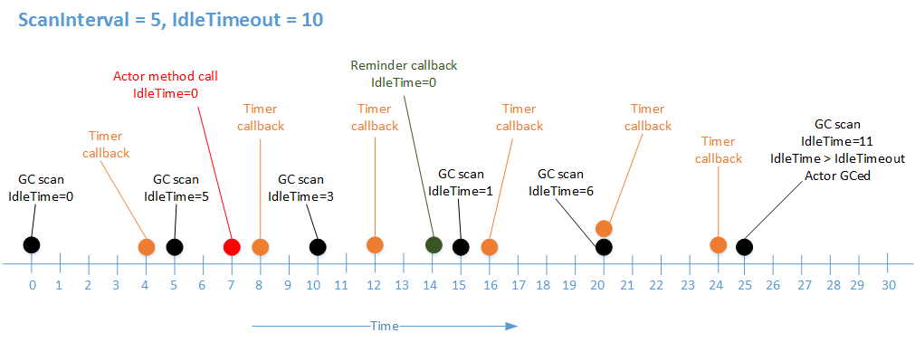
Lifecycle

Slide 62
Type | Actor Reactive | Node Restart | Service Republish | Cluster Restart | Service Recreated | Storage
None |  |  |  |  |  | None
Volatile |  |  |  |  |  | Memory
Persisted |  |  |  |  |  | Disk
Database |  |  |  |  |  | Database
State
Management

Slide 63
Demo
Actor
Actor Application
Partition
Availability
Scalability
State Manager

Slide 64
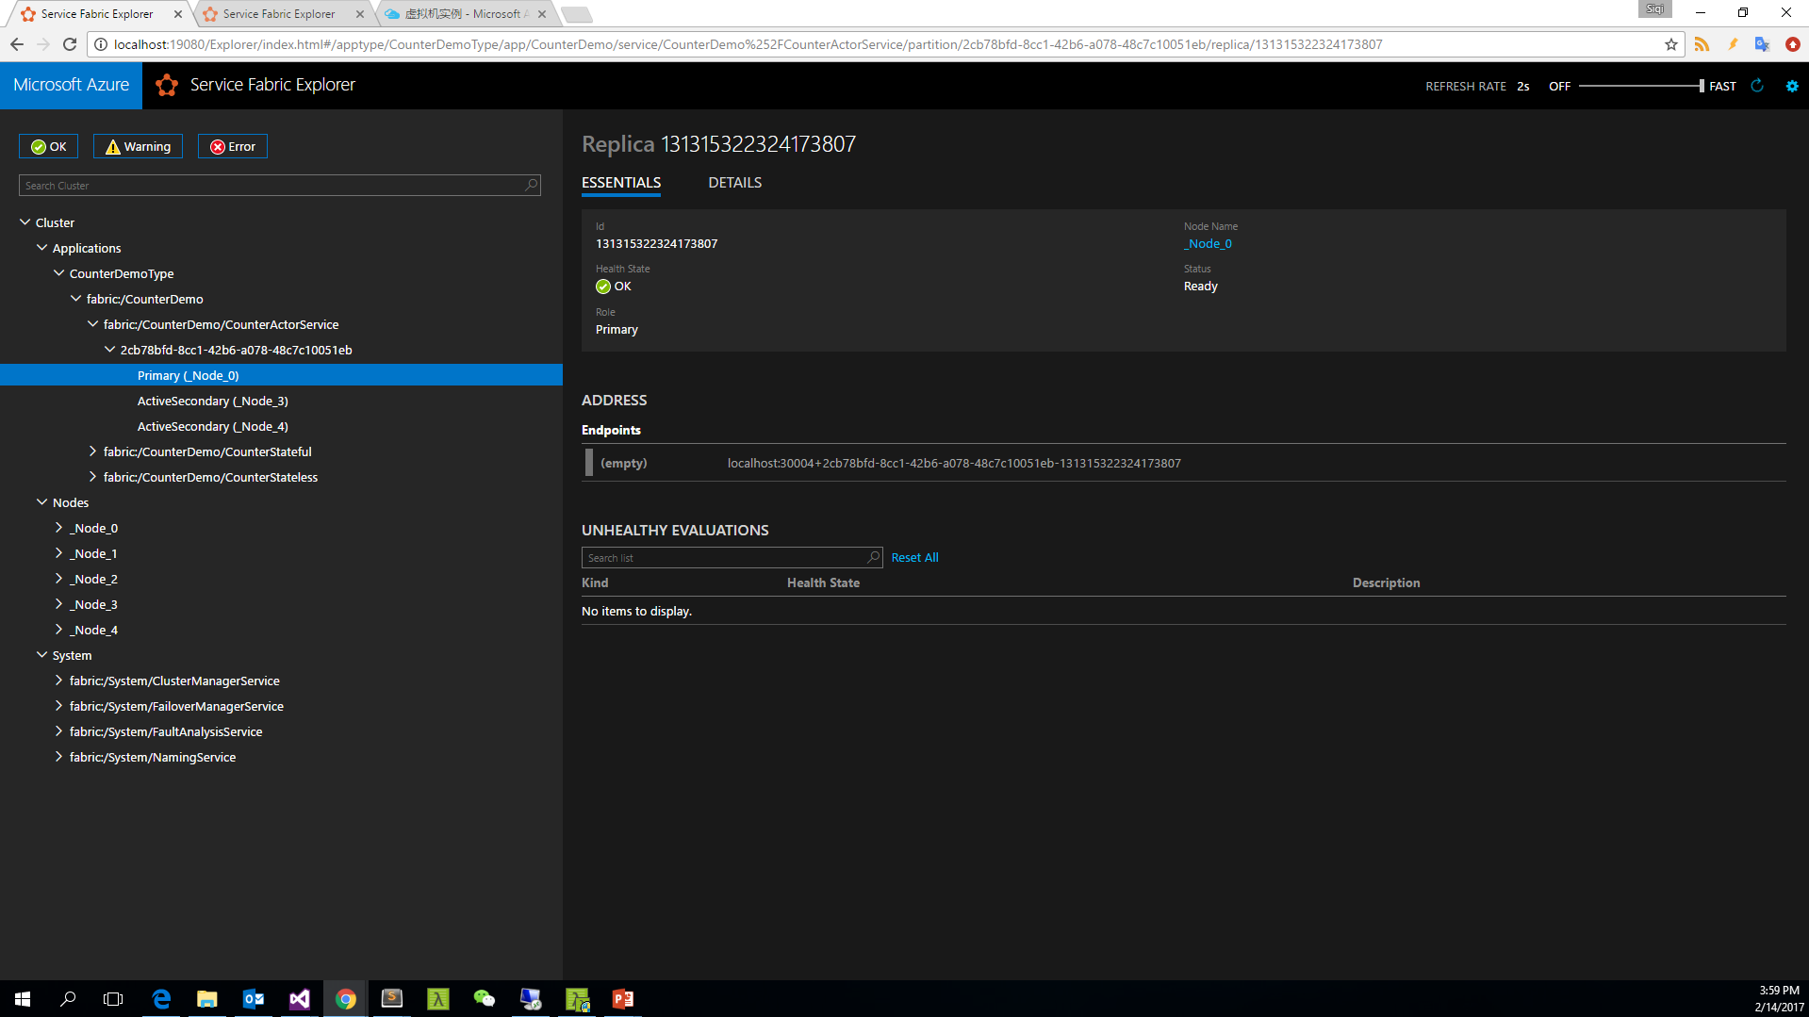

Slide 65
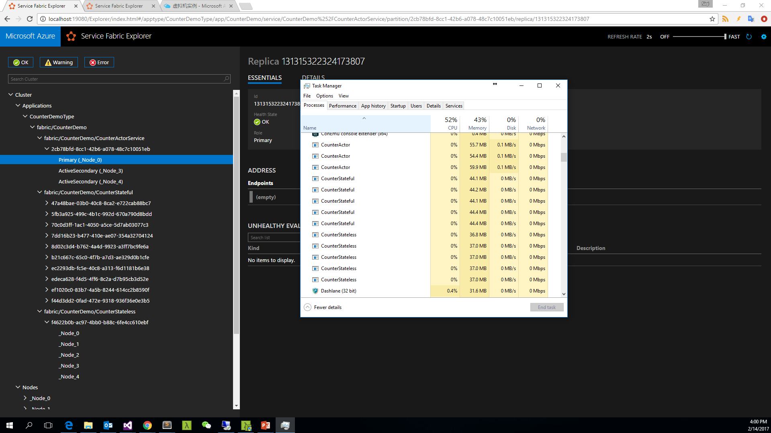

Slide 66
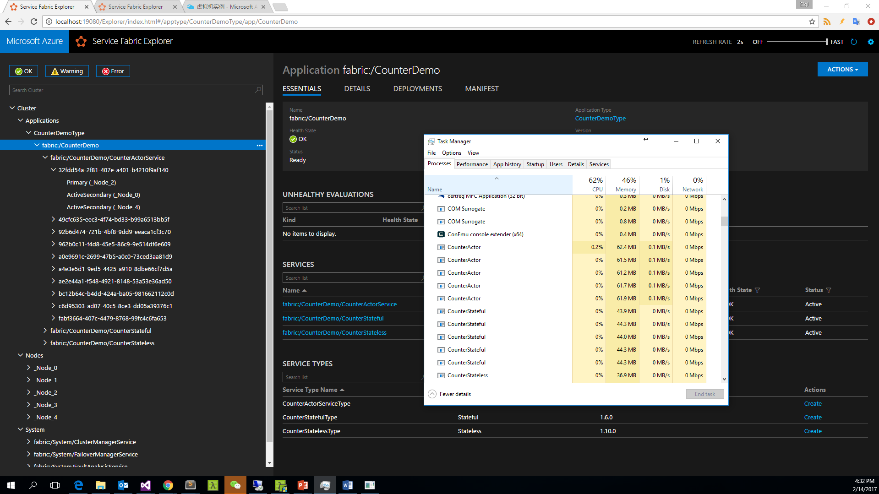
Notes:
有可能 ActiveSecondary 同时是2个 Partition 的 Replica，另外 Replica 的 Id 可能相同也可能不同，必须要同时使用 PartitionId 和 ReplicaId 才能唯一确定一个逻辑实例

Slide 67
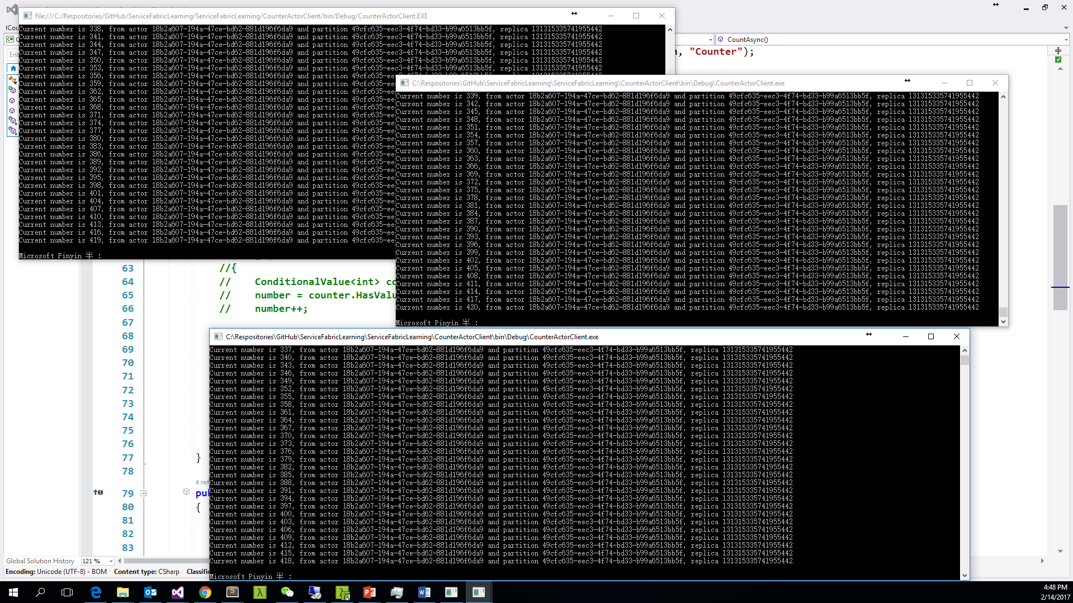
Notes:
Actor 稳定的并发机制

Slide 68
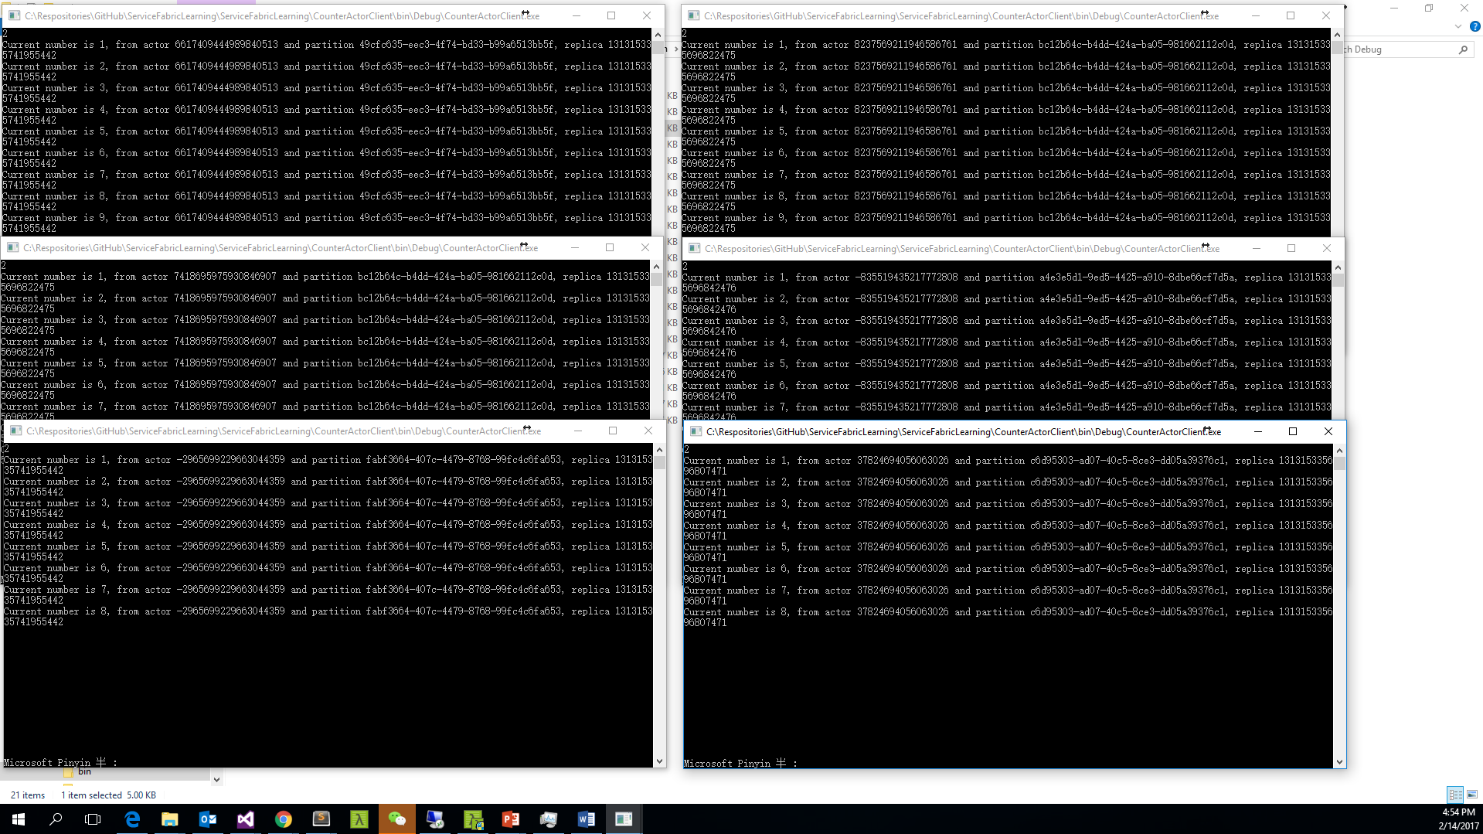
Notes:
Actor 与 Actor 之间是相互独立的，状态不共享

Slide 69
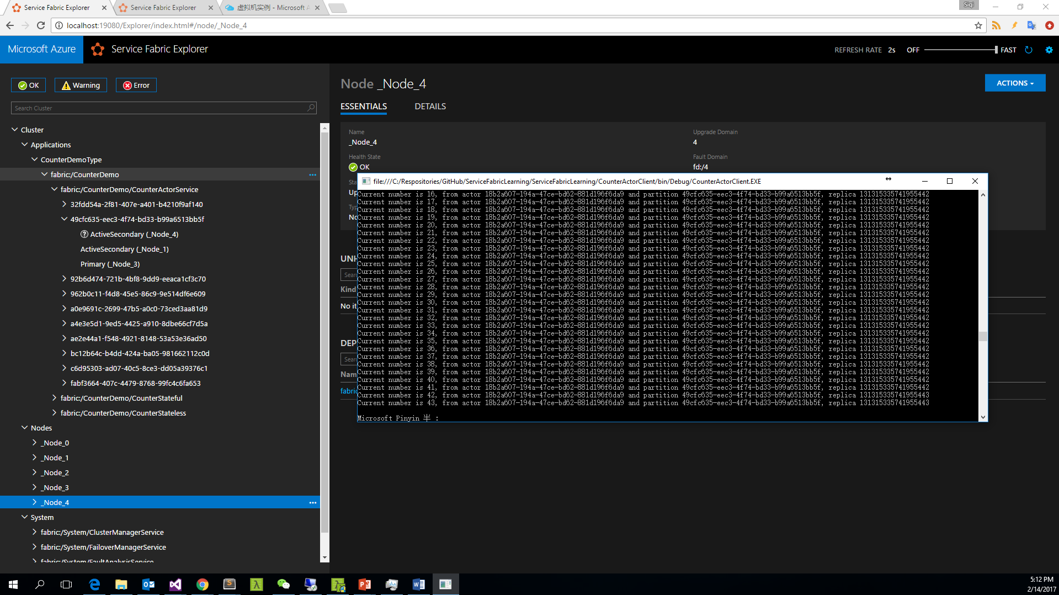
Notes:
StatePersistence.Persisted
Actor Reactive ： Keep
Node Restart ： Keep
Service Republish ： Keep
Cluster Restart：Keep
Service Recreated：None

Slide 70
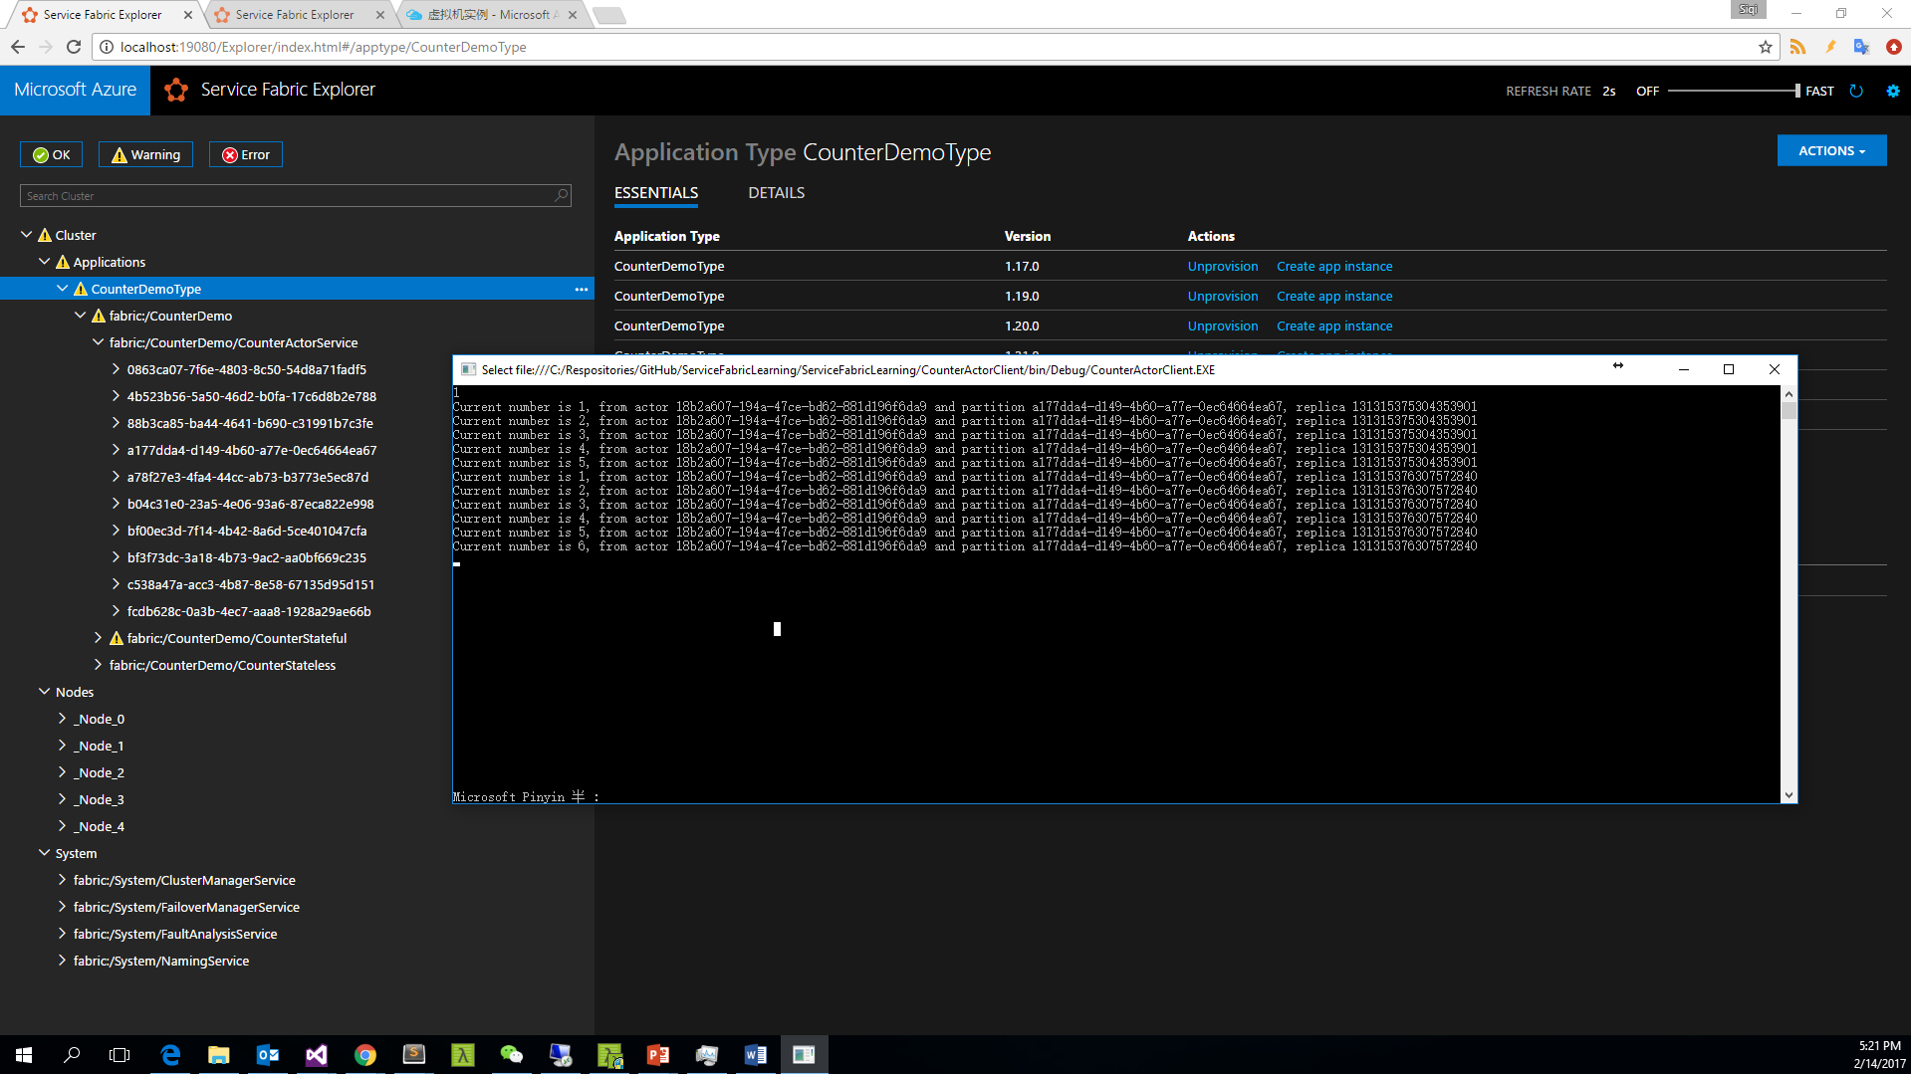
Notes:
StatePersistence.Volatile
Actor Reactive ： Keep
Node Restart ： Keep
Service Republish ： Keep
Cluster Restart：None
Service Recreated：None

Slide 71
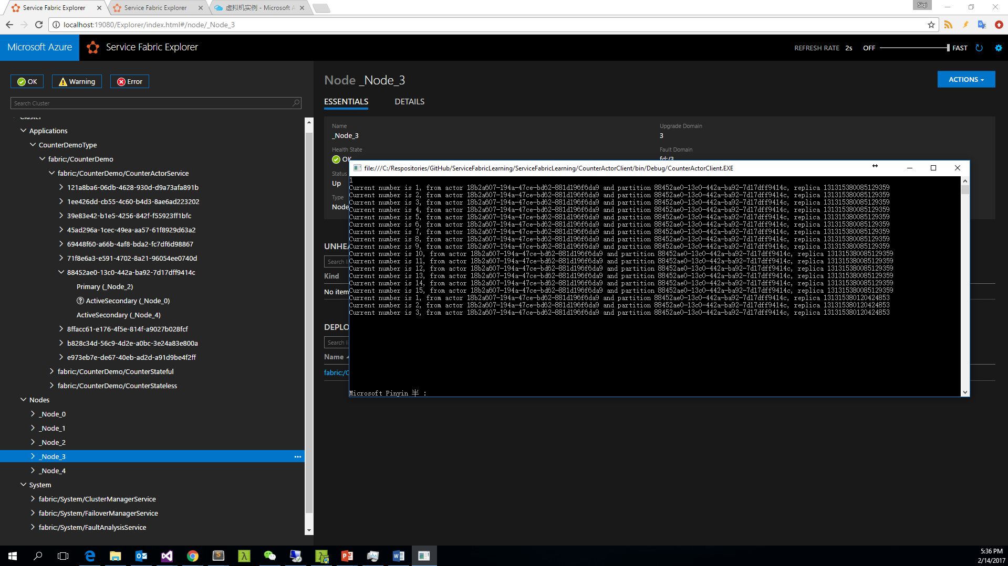
Notes:
StatePersistence.None
Actor Reactive ： None
Node Restart ： None
Service Republish ： None
Cluster Restart：None
Service Recreated：None

Slide 72
Service Fabric Programming Models

